Slide 1
NATURAL LANGUAGE PROCESSING (NLP) AN INTRODUCTION TO AI, ML, DEEP LEARNING & NLP
Welcome Here!!
DSN LEKKI-AJAH
BY ABEREJO HABEEBLAH O.
X (twitter): @haberejo
Day 1
Tuesday, 4th March, 2025

Slide 2
Why are we here
To equip learners with the skills to understand how Artificial Intelligence models are built, explore Machine Learning and Deep Learning, and focus on Natural Language Processing (NLP).
We should build some project right?
Yes!!
If you are in with me,
We should build some project.

Slide 3
Classes Structure
Every Tuesday throughout the month of March.
4 classes in total.
Each class for about 1:55 minutes
Days are NOT likely to change, although, my schedule can be OUCH, I wil reachout earlier before. Understand me bikoooo

Slide 4

Who should be here
You're curious and ready to learn something new
You dream of becoming a Data Scientist.
You're passionate about building the future as a Machine Learning Engineer.
You have a basic understanding of Python programming.
You've worked with data and want to take your skills to the next level.
You're a researcher exploring the exciting world of AI.
Which of these are you?

Slide 5
Who should be here
You're familiar with the fundamentals of Machine Learning and Deep Learning.
You love problem solving and are excited to tackle real world problems with AI.
You want to understand the technology that is shaping the future.
You're driven by a desire to learn and grow in the field of AI.
You enjoy collaborating and learning from others.
Which of these are you?????
You ticked any of these boxes?
Let’s Gooooooo

Slide 6
Where Do We Begin
- Know my audience
- Understand why they join this program
- Discuss previous projects and skills in AI
Let’s have some discussion here

Slide 7

Who I am?
Before we begin
- A Machine Learning Engineer
- A young MAN eager to master AI
FUN FACT:
I've taught over 100 people Python, but I'm still learning new things every day. (Especially how to avoid typos when coding late at night!)
Scan to visit my portfolio
or
https://bheez.netlify.app

Slide 8
Course Structure
1️⃣ Introduction to AI, ML, DL, and NLP
2️⃣ Understanding AI vs ML vs DL
3️⃣ Introduction to NLP
4️⃣ NLP Use Cases
5️⃣ Text Preprocessing Techniques
6️⃣ Hands-on NLP Tasks
7️⃣ Brain Teasers & Discussion
And lots more

Slide 9
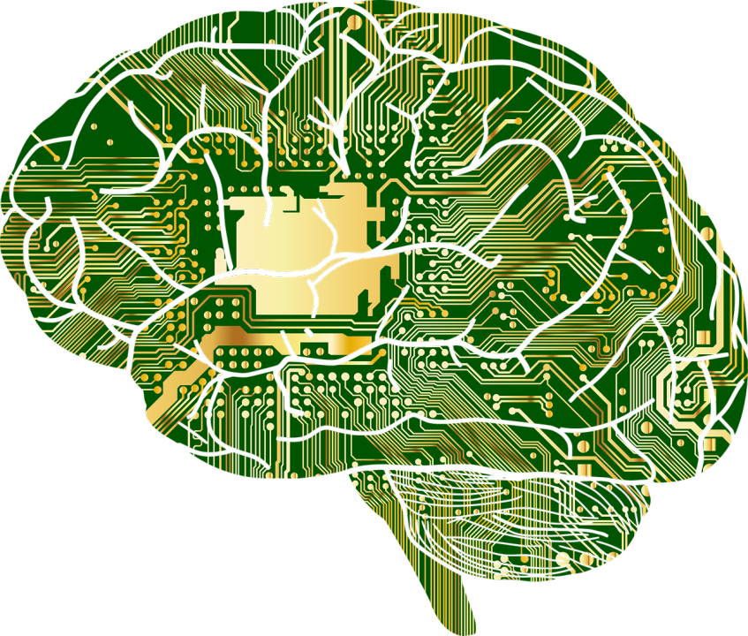
What is Artificial Intelligence (AI)
Artificial Intelligence is the ability of machines to mimic human intelligence. It enables computers and systems to learn from data, solve problem, and make decisions just like humans do.
AI is when machines start acting like they are smarter than humans.

Slide 10
What is Artificial Intelligence (AI)
Let’s relate like this again:
AI is like teaching your computer to do the thinking for you, only that it doesn’t demand coffee breaks or complain about Mondays!!
hahaha😃😃😃😃
AI is when machines start acting like they are smarter than humans.

Slide 11
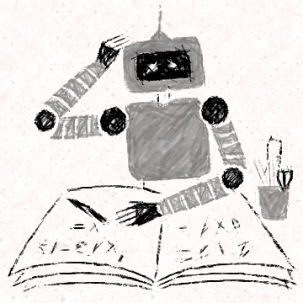
What is Machine Learning (ML)
Machine learning is turning things (data) into numbers and finding patterns in those numbers.
Got It???
Let’s Goooooo!!!

Slide 12
What is Machine Learning (ML)
Think of it as teaching a computer how to recognize patterns without explicitly programming it.
It uses some complex algorithms to find patterns.
Got It???
Let’s Goooooo!!!

Slide 13
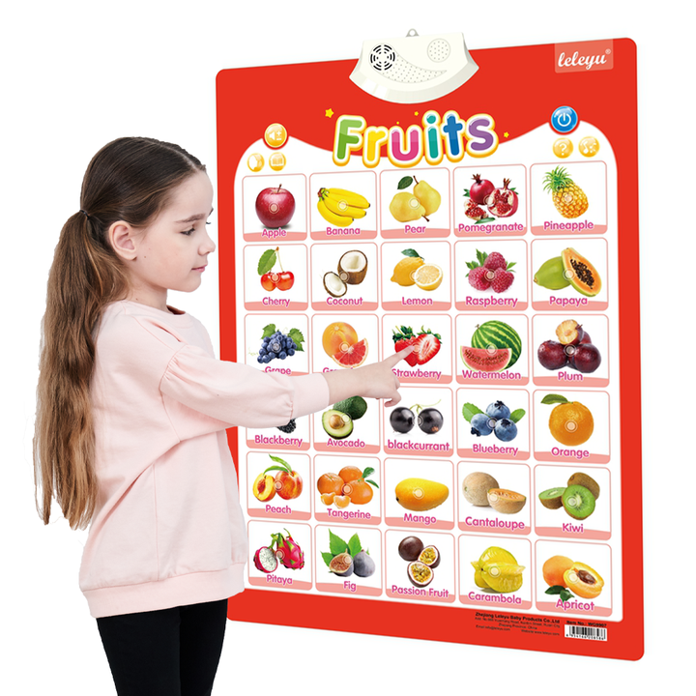
What is Machine Learning (ML)
Find pattern? How?
Imagine teaching a child to identify fruits. You show them a banana, an apple, and an orange, telling them the names. After seeing many examples, they can recognize a new banana without needing you to tell them. That’s what ML does—it learns from past examples and generalizes.
Got It??? Let’s Goooooo!!!

Slide 14
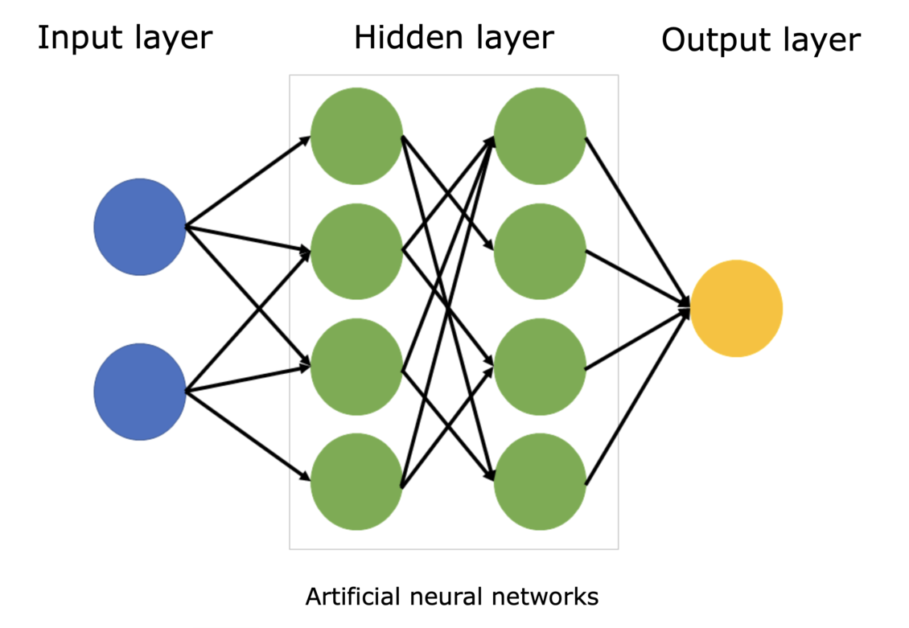
What is Deep Learning (DL)
A deeper version of ML.
It works like our brain with many layers of learning.
Instead of just learning basic rules, it finds complex patterns automatically by using lots of examples.
Got It???
Let’s Goooooo!!!

Slide 15
What is Deep Learning (DL)
It uses multi-layered neural networks (i.e. Deep Neural Networks) to automatically extract features from data.
It is especially effective for tasks like image recognition, speech processing, and NLP.
Got It???
Let’s Goooooo!!!

Slide 16
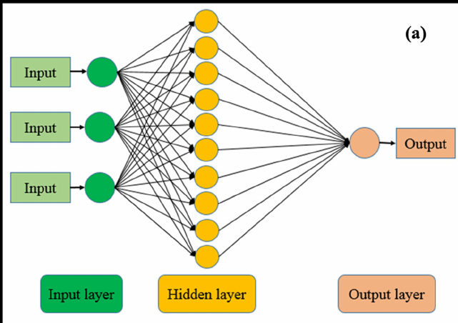
What is Deep Learning (DL)
Neural networks? How?
Imagine teaching a robot to recognize handwriting. Traditional ML would require manually programming rules for different letters. But Deep Learning would just look at thousands of handwritten examples and figure out the differences itself—like how humans learn handwriting by seeing and practicing.
Got It???
Let’s Goooooo!!!

Slide 17
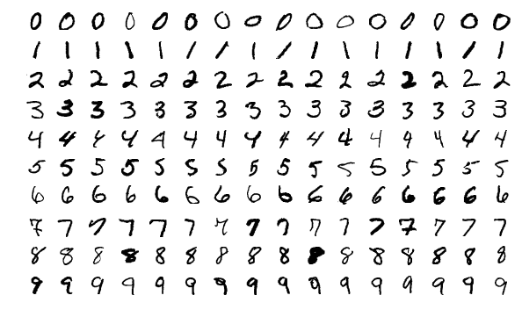
What is Deep Learning (DL)
Neural networks? How?
Got It???
Let’s Goooooo!!!

Slide 18
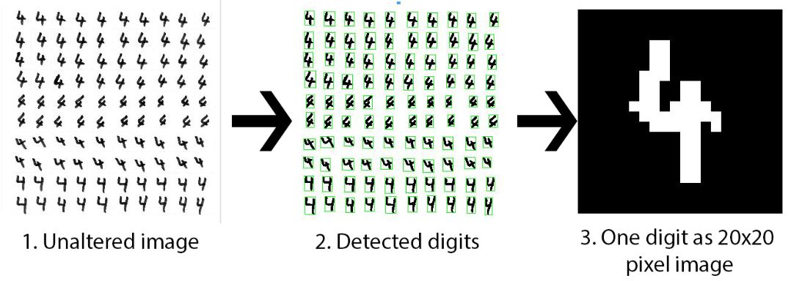
What is Deep Learning (DL)
Neural networks? How?

Slide 19
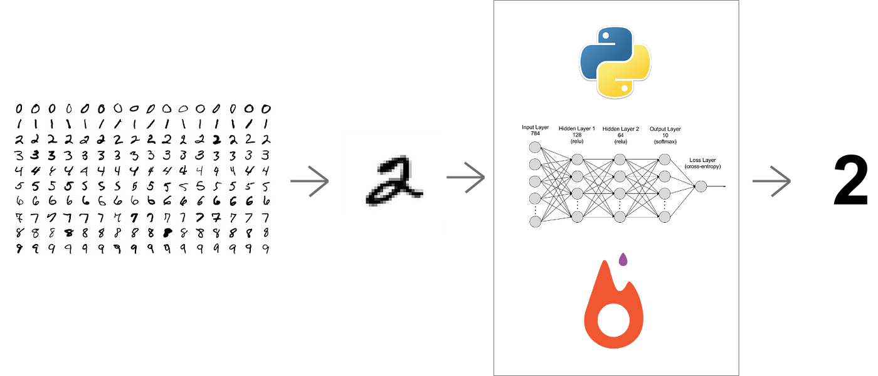
What is Deep Learning (DL)
Neural networks? How?

Slide 20

AI vs ML vs Deep Learning (DL)
AI is like a robotic assistant that can follow instructions,
ML is when it learns from experience,
DL is when it learns so deeply that it can recognize faces, voices, and even create art! 🎨🤖
Artificial Intelligence
Machine Learning
Deep
Learning
Where do we group NLP??

Slide 21
AI vs ML vs Deep Learning (DL)
Artificial Intelligence
Machine Learning
Deep
Learning
NLP is a sub of Deep Learning..

Slide 22
AI vs ML vs Deep Learning (DL)
Let’s relate with this:
AI is like a kitchen assistant following recipes, ML is like a cook who tweaks dishes based on feedback, and DL is like a top chef who invents new recipes just by understanding flavors! 🍳🤖🔥
Artificial Intelligence
Machine Learning
Deep
Learning
Got It???
Let’s Goooooo!!!

Slide 23
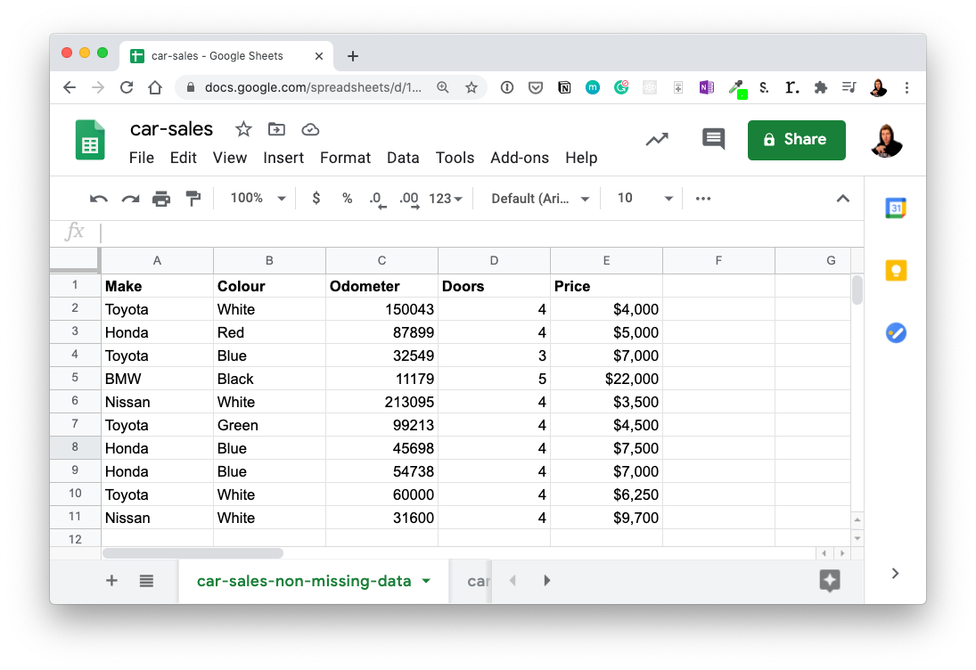


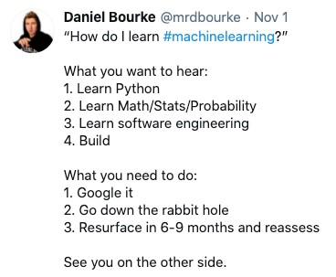



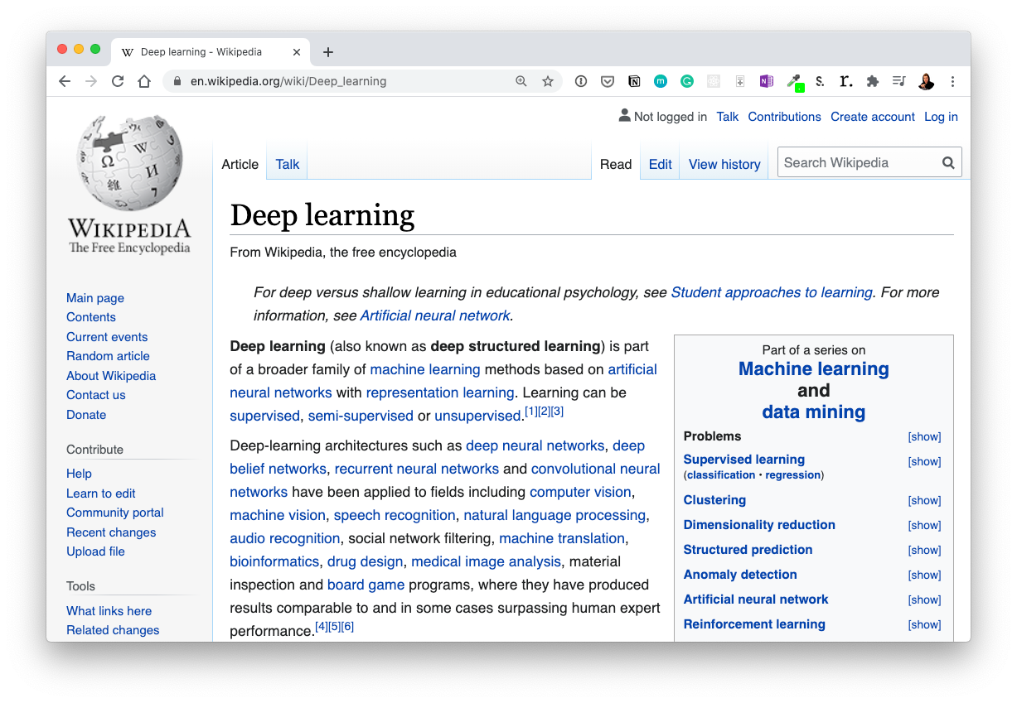

ML vs DL
..
Machine Learning
Deep Leanring
Structured data
Unstructured Data

Slide 24
AI vs ML vs Deep Learning (DL)
Can AI exist without Machine Learning or Deep Learning???
Artificial Intelligence
Machine Learning
Deep
Learning
Got It???
Let’s Goooooo!!!

Slide 25
AI vs ML vs Deep Learning (DL)
Can AI exist without Machine Learning or Deep Learning???
The answer is yes, AI can exist without ML or DL, although it might not be the kind of AI we often see in movies or science fiction.
Artificial Intelligence
Machine Learning
Deep
Learning
Got It???
Let’s Goooooo!!!

Slide 26
AI vs ML vs Deep Learning (DL)
AI encompasses any technique that enables computers to mimic human intelligence.
Rule-based systems were an early form of AI that relied on predefined rules rather than learning from data.
Machine Learning and Deep Learning, although dominant today, are subsets of AI that use algorithms to learn from data.
Artificial Intelligence
Machine Learning
Deep
Learning
Got It???
Let’s Goooooo!!!

Slide 27
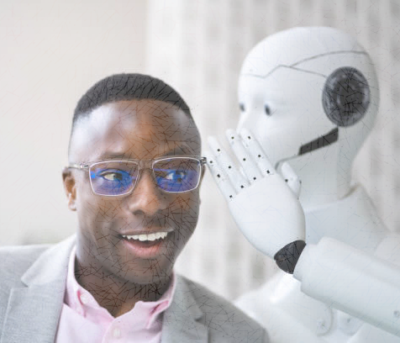
What is Natural Language Processing (NLP)
NATURAL LANGUGAE PROCESSING (NLP) helps computers understand and talk like humans.
It enables computers to read, interpret, and generate human-like text.
It allows your phone to predict your next word, understand voice commands, and translate languages.

Slide 28
What is Natural Language Processing (NLP)
NLP combines ML and Deep Learning to process and understand human language.
Includes tasks like stemming, tokenization, NER, sentiment analysis.
NER – named entity recognition
Here is a scenario; Imagine chatting with a smart assistant (like ChatGPT or Siri). You say, “What’s the weather today?”, and it understands your words, fetches present weather data, and responds. That’s NLP in action.

Slide 29
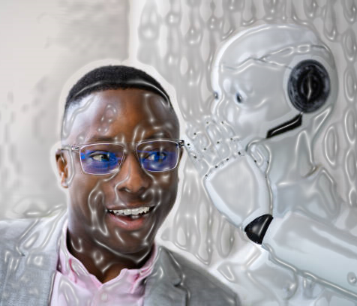
Natural Language Processing (NLP) in Industry
Voice Assistants 🎙️: Siri, Alexa, and Google Assistant understand and respond to your voice commands.
Chatbots 💬: Websites use NLP-powered bots to answer your questions instantly.
Autocorrect & Predictive Text 📱: Your phone suggests next words while typing to speed things up, Also can correct spellings when you typed wrongly.
All this industry examples uses NLP in operation.

Slide 30
Natural Language Processing (NLP) in Industry
Translation Apps 🌍: Google Translate helps you understand different languages.
Spam Filters 📧: Your email sorting out spam messages automatically.
Search Engines 🔍: To understands what you mean, even if you type a messy query.
Sentiment Analysis 😃😡: Companies analyze tweets and reviews to see what people feel about their brand.
All this industry examples uses NLP in operation. Can I get from you??

Slide 31
NLP use cases
“What’s the topic of this text?” (text classification)
“Does this text contain abuse?” (content filtering)
“Does this text sound positive or negative?” (sentiment analysis)
“What should be the next word in this incomplete sentence?” (language modeling)
“How would you say this in German?” (translation)
“How would you summarize this article in one paragraph?” (summarization)
Got The Point Now????

Slide 32
Brief History of Natural Language Processing (NLP)
2011: George Dahl and Microsoft Research trained a deep neural network to recognize words from speech recordings—a major deep learning breakthrough in NLP.
2012: AlexNet revolutionized deep learning in image recognition, leading to increased interest in machine vision.
2015: Deep learning models started competing in NLP tasks like machine translation, matching traditional ML accuracy with less effort and lower computational cost.
2016-2017: Deep learning models in NLP became more efficient and began outperforming traditional ML approaches in accuracy.
Impact: Enabled real-time translation on mobile devices without requiring an internet connection, making NLP more accessible and practical.

Slide 33
What’s Next 😃😃
Maybe I don’t know also
After all of the theoretical explanation, can we begin some hands-on or we stop here today?

Slide 34
What’s Next 😃😃
Maybe I don’t know also
If Yes, 😃😃
Let’s get our Machine setup for hands-on.

Slide 35
Setting up our PC
We need install some tools if we are to work locally (i.e without internet)
Since we are online, we may not delve into this page in details
If you will be working locally, make sure to install the following
Python (ensure to add to path when installing)
Jupyter Lab (I like to use command - pip install jupyterlab – in my CMD/Terminal)
Tensorflow (use the command - pip install tensorflow – into your CMD/Terminal)
Some frameworks and libraries we will use as we move
If working online,
Visit google colab and let’s start

Slide 36
What’s Next 😃😃
Maybe I don’t know also
After setup,
Let’s begin proper proper
😃😃

Slide 37
The END
DSN LEKKI-AJAH
BY ABEREJO HABEEBLAH O.
X: @haberejo
Day 1

Slide 38
NATURAL LANGUAGE PROCESSING (NLP) TEXT PREPROCESSING AND TOKENIZATION
DSN LEKKI-AJAH
BY ABEREJO HABEEBLAH O.
X: @haberejo
Day 2

Slide 39
How computer sees language
Computers see text as a sequence of character,
Computers don’t understand words or meaning like humans do
They see all English words as binary language (i.e. 1s and 0s)
So, now, we need to help computer understand our language to what it can fully understand
What do we do to help computers understand the text? Let’s GO
Binary Language == 1 and 0

Slide 40
Understand Human Language
There are arguably 3 steps to help computer understand human texts,
Text Preprocessing
Tokenization
Numerical Representation (Word Embedding)
Now, Lets discuss each further!!
Binary Language == 1 and 0

Slide 41
Step 1: Text Preprocessing
Why Preprocess Text?
Imagine you have a room full of clothes, toys, and papers scattered everywhere. Finding what you need is hard, right?
Raw text data is similar. It's full of "noise" – things that make it difficult for computers to understand the meaning.
Got It???
Let’s Goooooo!!!

Slide 42
Step 1: Text Preprocessing
At this stage, lets understand preprocessing of text,
Proper Text preprocessing is important to make sure we are only feeding the right processed information into our algorithm and irrelevant text are gone.
Got It???
Let’s Goooooo!!!
e.g: The Quick! bRoWn foX juMPS.

Slide 43
Step 1: Text Preprocessing
Text preprocessing cleans and prepares text data for NLP tasks. It addresses issues like inconsistencies (uppercase/lowercase), irrelevant information (stop words), and variations in word forms (running vs. run). This makes it easier for NLP models to learn.
Got It???
Let’s Goooooo!!!
e.g: The Quick! bRoWn foX juMPS.

Slide 44
Step 1: Text Preprocessing
We prepare text by:
Lowercasing
Removing Punctuation Marks
Removing Stopwords (i.e words like A, of, in, etc)
Stemming / Lemmatization
NB:
There is no specific way to prepare text, it is much dependent on what type of NLP project we are building!
e.g: The Quick! bRoWn foX juMPS.

Slide 45
Step 1: Text Preprocessing
1. Lowercasing: To humans, A capitalized word at the beginning of a sentence (e.g., She) has the same meaning as when it’s used later in a sentence (she).
By converting all characters in a corpus to lowercase, we disregard any use of capitalization.
Computers treat "The" and "the" as different words. Lowercasing makes everything consistent.
The Quick! bRoWn foX juMPS.
the quick! brown fox jumps.
NB:
Corpus in this regard means collection of writings.

Slide 46
Step 1: Text Preprocessing
Though, in a larger corpus that has many more examples of individual uses of words, the word, general (an adjective meaning “widespread”) have different meaning to the word General (a noun meaning the commander of an army). One option is not to lowercase everything, or try an option called Part-Of-Speech (POS) Tagging
The Quick! bRoWn foX juMPS.
the quick! brown fox jumps.
NB:
Corpus in this regard means collection of writings.

Slide 47
Step 1: Text Preprocessing
2. Removing Punctuation Marks: Punctuation marks generally don’t add much value to a natural language model and so are often removed.
Removing punctuation would not be an advantage in all cases. Consider, for example, if you were building a question-answering algorithm, which could use question marks to help it identify questions.
The Quick! bRoWn foX juMPS.
the quick brown fox jumps
Depending on the NLP project, some steps are compulsory

Slide 48
Step 1: Text Preprocessing
3. Removing Stopwords: Stopwords are frequently occurring words that tend to contain relatively little distinctive meaning, such as the, at, which, and, of etc.
There is no universal consensus on the precise list of stop words, but depending on your application it may be sensible to ensure that certain words are (or aren’t!) considered to be stop words.
The Quick! bRoWn foX juMPS.
quick brown fox jumps
Depending on the NLP project, some steps are compulsory

Slide 49
Step 1: Text Preprocessing
For example, when building a model to classify movie reviews as positive or negative. Some lists of stop words include negations like didn’t, isn’t, and wouldn’t that might be critical for our model to identify the sentiment of a movie review, so these words probably shouldn’t be removed.
Negations may be helpful as stop words for some classifiers but probably not for a sentiment classifier
So be careful with this one. In many instances, it will be best to remove only a limited number of stop words.
The Quick! bRoWn foX juMPS.
quick brown fox jumps
Depending on the NLP project, some steps are compulsory

Slide 50
Step 1: Text Preprocessing
4. Stemming / Lemmatization:
Stemming: Stemming is the truncation of words down to their stem, i.e their root form.
For example, the words house, housed and housing both have the stem hous.
With smaller datasets in particular, stemming can be productive because it pools words with similar meanings into a single token.
The Quick! bRoWn foX juMPS.
quick brown fox jumps
Depending on the NLP project, some steps are compulsory

Slide 51
Step 1: Text Preprocessing
There will be more examples of this stemmed token’s context, enabling techniques like word2vec or GloVe to more accurately identify an appropriate location for the token in word-vector space
To stem words, you can use the Porter algorithm5 provided by nltk. To do this, you create an instance of a PorterStemmer() object and then add its stem() method
The Quick! bRoWn foX juMPS.
quick brown fox jumps
NLTK == Python Natural Language Toolkit. It’s a package

Slide 52
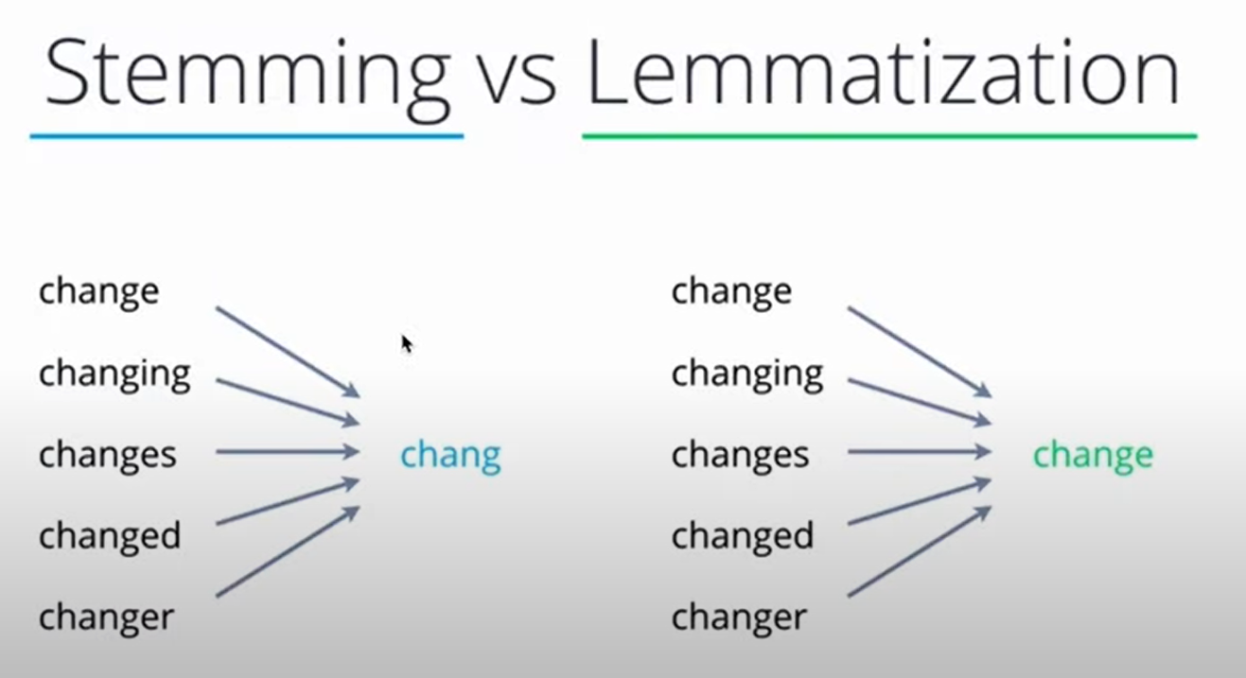
Step 1: Text Preprocessing
From this comparison, Stemming returns to its root form. Stemming is quite harsh
While
Lemmatization is quite flexible and return it to a common word.
Choose based on the kind of words you have and your project.

Slide 53
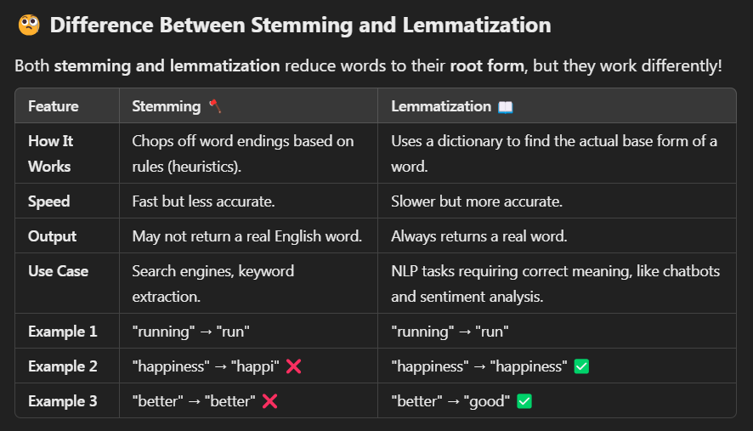
Step 1: Text Preprocessing
Stemming follows simple rules to cut off suffixes like -ing, -ed, or -ly.
Lemmatization uses linguistic knowledge to find the true root form of a word.

Slide 54
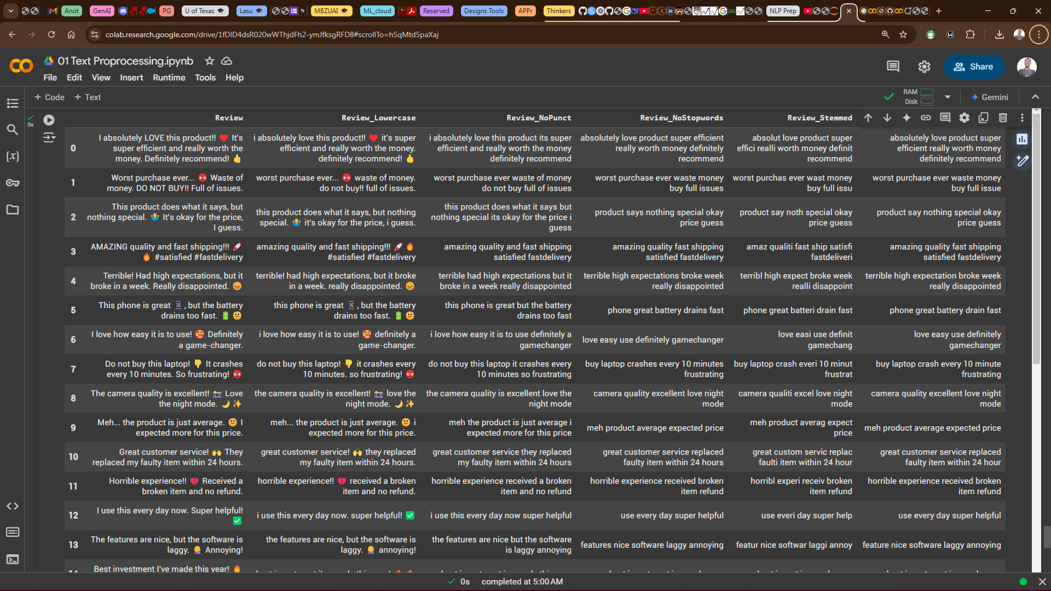
Step 1: Text Preprocessing
Love it Right????, I love it too

Slide 55
Some Discussion
Text -> Turn into numbers -> build a model -> train the model to find patterns -> use patterns (make predictions)
That’s the flow
🧠 🧠 🧠 🧠 🧠 🧠 🧠 🧠 🧠 🧠 🧠 🧠 🧠 🧠 🧠 🧠 🧠 🧠 🧠 🧠 🧠 🧠 🧠 🧠 🧠 🧠 🧠 🧠 🧠 🧠 🧠 🧠 🧠 🧠 🧠 🧠 🧠 🧠 🧠 🧠 🧠 🧠 🧠 🧠 🧠 🧠 🧠 🧠

Slide 56
📌 Everything in a tip
You've successfully completed text preprocessing on customer feedback data. We've covered:
✔️ Lowercasing – Ensuring consistency in text.
✔️ Removing Punctuation & Emojis – Cleaning unnecessary characters.
✔️ Stopword Removal – Keeping only meaningful words.
✔️ Stemming & Lemmatization – Reducing words to their root form for better NLP.
🔥🔥 🔥🔥🔥 🔥🔥🔥 🔥🔥🔥 🔥🔥🔥 🔥🔥🔥 🔥

Slide 57
Let’s move on
Text -> turn into numbers -> build a model -> train the model to find patterns -> use patterns (make predictions)
If you understand everything up to this point, identify yourself as a Machine Learning Engineer specializing in Natural Language Processing! 😃😃😃😃
🧠 🧠 🧠 🧠 🧠 🧠 🧠 🧠 🧠 🧠 🧠 🧠 🧠 🧠 🧠 🧠 🧠 🧠 🧠 🧠 🧠 🧠 🧠 🧠 🧠 🧠 🧠 🧠 🧠 🧠 🧠 🧠 🧠 🧠 🧠 🧠 🧠 🧠 🧠 🧠 🧠 🧠 🧠 🧠 🧠 🧠 🧠 🧠

Slide 58

QUESTIONS AND ANSWER

Slide 59
The END
Day 1
DSN LEKKI-AJAH
BY ABEREJO HABEEBLAH O.
X: @haberejo
Next Class schedule:
Tuesday, 11th March, by 5:00pm.

Slide 60
🧠 Time for quick Brain Teaser🔍
We've cleaned, transformed, and optimized text like real NLP pros! Now, let's see how well you followed along.🧐
Question: Given this raw text:👉
"I'm LOVING this NLP session!!! 😍🔥 It's AMAZING how we can clean text properly. But... is it always the best approach?“
If we apply the following preprocessing steps, what will be the output at each stage?
1️⃣ Lowercasing: What does the text look like after converting to lowercase?

Slide 61
🧠 Time for quick Brain Teaser🔍
1️⃣ Lowercasing: What does the text look like after converting to lowercase?
"I'm LOVING this NLP session!!! 😍🔥 It's AMAZING how we can clean text properly. But... is it always the best approach?“
✅ "i'm loving this nlp session!!! 😍🔥 it's amazing how we can clean text properly. but... is it always the best approach?"

Slide 62
🧠 Time for quick Brain Teaser🔍
Question: Given this raw text:👉
"I'm LOVING this NLP session!!! 😍🔥 It's AMAZING how we can clean text properly. But... is it always the best approach?“
If we apply the following preprocessing steps, what will be the output at each stage?
2️⃣ Removing Punctuation & Emojis: What’s left after getting rid of #,!, 😍🔥, and other punctuation marks?

Slide 63
🧠 Time for quick Brain Teaser🔍
2️⃣ Removing Punctuation & Emojis: What’s left after getting rid of #,!, 😍🔥, and other punctuation marks?
"I'm LOVING this NLP session!!! 😍🔥 It's AMAZING how we can clean text properly. But... is it always the best approach?“
✅ "im loving this nlp session its amazing how we can clean text properly but is it always the best approach"

Slide 64
🧠 Time for quick Brain Teaser🔍
Question: Given this raw text:👉
"I'm LOVING this NLP session!!! 😍🔥 It's AMAZING how we can clean text properly. But... is it always the best approach?“
If we apply the following preprocessing steps, what will be the output at each stage?
3️⃣ Stopword Removal: Which words will be removed, and what remains?

Slide 65
🧠 Time for quick Brain Teaser🔍
3️⃣ Stopword Removal: Which words will be removed, and what remains?
"I'm LOVING this NLP session!!! 😍🔥 It's AMAZING how we can clean text properly. But... is it always the best approach?“
✅ "loving nlp session amazing clean text properly always best approach"

Slide 66
🧠 Time for quick Brain Teaser🔍
Question: Given this raw text:👉
"I'm LOVING this NLP session!!! 😍🔥 It's AMAZING how we can clean text properly. But... is it always the best approach?“
If we apply the following preprocessing steps, what will be the output at each stage?
4️⃣ Stemming & Lemmatization: If we use:
Porter Stemmer, how would words like "loving" and "amazing" change?
Lemmatization, what would be the base form of "loving" and "clean"?

Slide 67
🧠 Time for quick Brain Teaser🔍
4️⃣ Stemming & Lemmatization: If we use:
Porter Stemmer, how would words like "loving" and "amazing" change?
"I'm LOVING this NLP session!!! 😍🔥 It's AMAZING how we can clean text properly. But... is it always the best approach?“
loving" → "love“
"amazing" → "amaz“
"clean" → "clean" (remains the same)
✅ "love nlp session amaz clean text proper always best approach"

Slide 68
🧠 Time for quick Brain Teaser🔍
4️⃣ Stemming & Lemmatization: If we use: Lemmatization (Using WordNet Lemmatizer), what would be the base form of "loving" and "clean"?
"I'm LOVING this NLP session!!! 😍🔥 It's AMAZING how we can clean text properly. But... is it always the best approach?“
"loving" → "love“
"amazing" → "amazing" (unchanged)
"clean" → "clean“
✅ "love nlp session amazing clean text properly always best approach"

Slide 69
🧠 🚀 Bonus Question: 🔍
We removed stopwords to clean up our text. But can you think of a situation where removing stopwords might actually hurt the meaning or usefulness of our data?🤔
What can be done in such case???
💡 Hint: Think about cases where small words like "not," "is," or "to" are important in understanding the sentence.
Open-ended answers are welcomed!!!

Slide 70
🧠 🚀 Bonus Question: 🔍
Answer: ✅ Yes! There are several cases where stopwords play a crucial role:
1️⃣ Sentiment Analysis – Words like "not" and "very" can change sentiment.
Example: "The movie is not bad" (removing "not" changes the meaning).
2️⃣ Question Answering – Stopwords help retain context in queries.
Example: "What is the capital of France?" makes more sense than just "capital France?’’
3️⃣ Machine Translation – Removing stopwords might lead to incorrect translations.
Example: Translating "I am going to the market" without "am" and "to" could alter the meaning.
So, while removing stopwords often helps clean data, it's important to consider the task before blindly dropping them! 🚀

Slide 71
🧠 Try This
💡 Try This! Modify the dataset with your own text and observe how preprocessing affects different types of input.
Generate into a CSV File and share before the end of the program.
Let’s keep building! 🔥🔥🔥

Slide 72
Let’s move on
Text -> turn into numbers -> build a model -> train the model to find patterns -> use patterns (make predictions)
If you understand everything up to this point, identify yourself as a Machine Learning Engineer specializing in Natural Language Processing! 😃😃😃😃
🧠 🧠 🧠 🧠 🧠 🧠 🧠 🧠 🧠 🧠 🧠 🧠 🧠 🧠 🧠 🧠 🧠 🧠 🧠 🧠 🧠 🧠 🧠 🧠 🧠 🧠 🧠 🧠 🧠 🧠 🧠 🧠 🧠 🧠 🧠 🧠 🧠 🧠 🧠 🧠 🧠 🧠 🧠 🧠 🧠 🧠 🧠 🧠

Slide 73
The END
Day 1
DSN LEKKI-AJAH
BY ABEREJO HABEEBLAH O.
X: @haberejo
Next Class schedule:
Tuesday, 11th March, by 5:00pm.

Slide 74
Step 2: Tokenization
What is Tokenization?
Tokenization is the process of splitting a text into individual units, called tokens.
These tokens can be words, subwords, characters, or even punctuation marks. It’s an important step in most NLP pipelines, as it prepares the text for further processing.

Slide 75
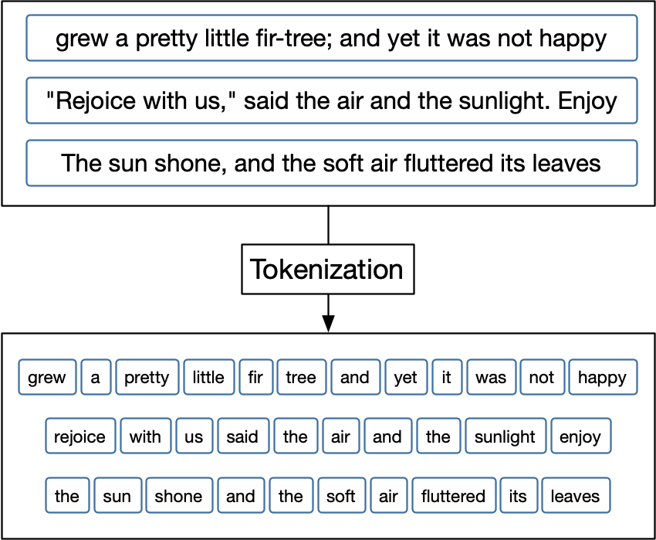
Step 2: Tokenization
What is a Token?
Tokens make it easier for computers to analyze text.
E.G: grew is a token.
Pretty is a token

Slide 76
Step 2: Tokenization
There are different types of tokenization:
Sentence Tokenization (Sentence-Level Tokenization)
Word Tokenization (Word-Level Tokenization)
Subword Tokenization
Character-level Tokenization

Slide 77
Step 2: Tokenization
There are different types of tokenization:
Sentence Tokenization (Sentence-Level Tokenization): Splits text into individual sentences. Important for tasks like text summarization or machine translation.
Example:
"The cat sat on the mat. The dog barked."
becomes
["The cat sat on the mat.", "The dog barked."]
Uses the .sent_tokenize() method of the nltk.tokenize library

Slide 78
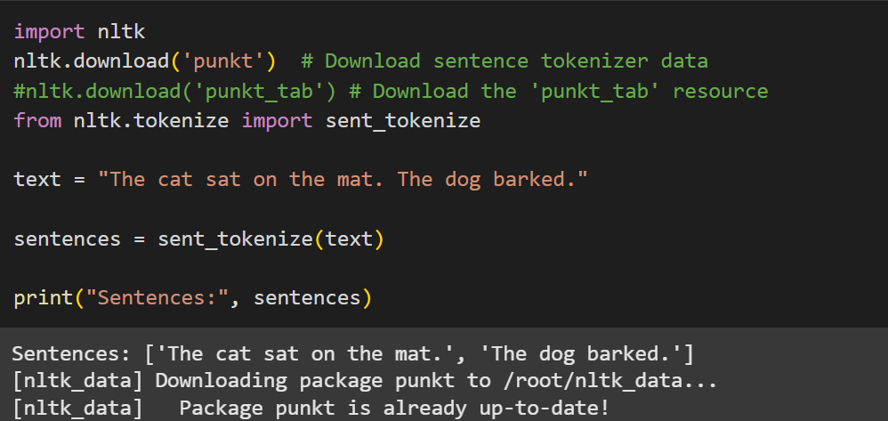
Step 2: Tokenization
Code sample:

Slide 79
Step 2: Tokenization
Word Tokenization (Word-Level Tokenization): Splits text into individual words. This is the most common type.
Example:
"The cat sat on the mat. The dog barked."
becomes
['The', 'cat', 'sat', 'on', 'the', 'mat', '.', 'The', 'dog', 'barked', '.’]
Uses the .word_tokenize() method of the nltk.tokenize library

Slide 80
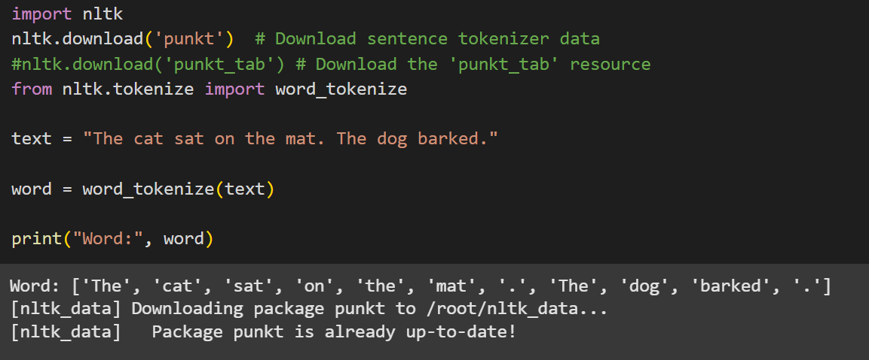
Step 2: Tokenization
Code sample:

Slide 81
Step 2: Tokenization
Word tokenization and other examples are great, but what happens when our computer encounters a word it hasn't seen before?
Imagine you're learning English and you come across the word 'unbreakable.' You might not know it, but you know 'break' and 'able’.
Think of learning a new language. You might not know every single word, but you can often figure out the meaning of a new word if you recognize parts of it.
Subword tokenization is a way to handle these 'out-of-vocabulary' (OOV) words. It breaks words into smaller parts, called subwords, so the computer can understand them even if it hasn't seen the whole word before.

Slide 82
Step 2: Tokenization
Subword Tokenization: Splits words into smaller units (subwords). This is crucial for handling out-of-vocabulary words and morphologically rich languages. Common methods include Byte Pair Encoding (BPE) and WordPiece.
Example:
"unbreakable"
might be tokenized as
["un", "break", "able"].
This allows the model to understand the meaning even if it hasn't seen "unbreakable" before, as it recognizes "break," "un," and "able."

Slide 83
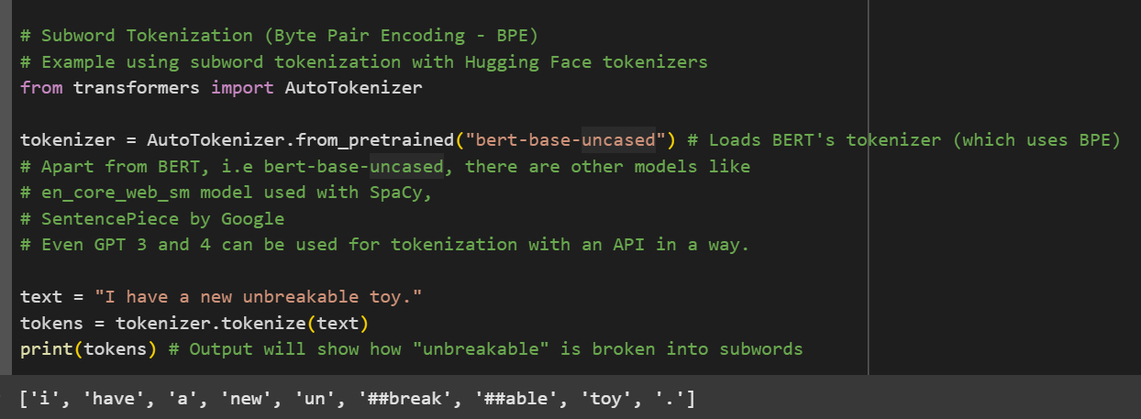
Step 2: Tokenization
Code sample:

Slide 84
Step 2: Tokenization
Character-level Tokenization: Splits text into individual characters. Useful for languages with complex morphology or when dealing with misspellings.
Example:
"cat"
becomes
["c", "a", "t"]
Character-level Tokenization are useful in Spelling Corrections, New text Generation as learned from patterns of character sequences and also when handling noisy data.

Slide 85
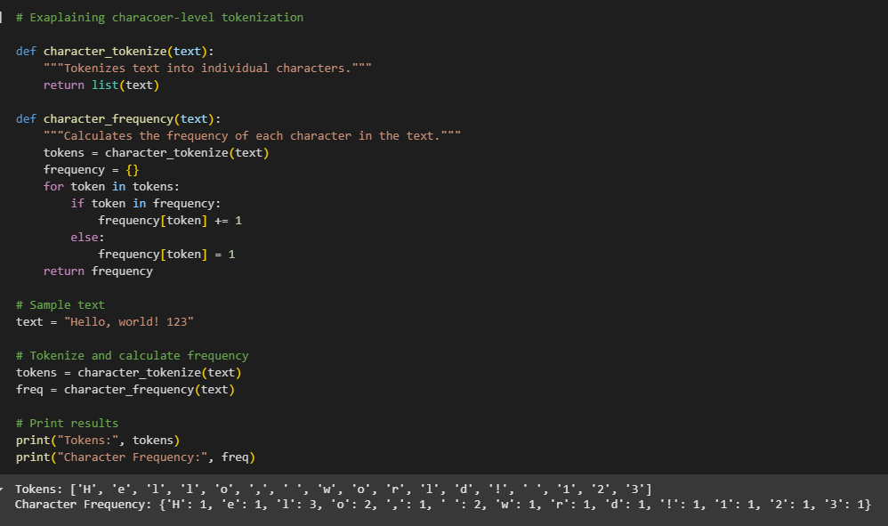
Step 2: Tokenization
Code sample:

Slide 86
Step 2: Tokenization
While character-level tokenization offers advantages, it also has drawbacks:
Longer Sequences: Character sequences are much longer than word sequences, which can make training models more computationally expensive.
Loss of Word-Level Meaning: It doesn't capture the semantic meaning of words as effectively as word-level or subword tokenization.

Slide 87
The END
DSN LEKKI-AJAH
BY ABEREJO HABEEBLAH O.
X: @haberejo
Day 2

Slide 88
NATURAL LANGUAGE PROCESSING (NLP) NUMERICAL REPRESENTATION (EMBEDDING)
DSN LEKKI-AJAH
BY ABEREJO HABEEBLAH O.
X: @haberejo
Day 3

Slide 89
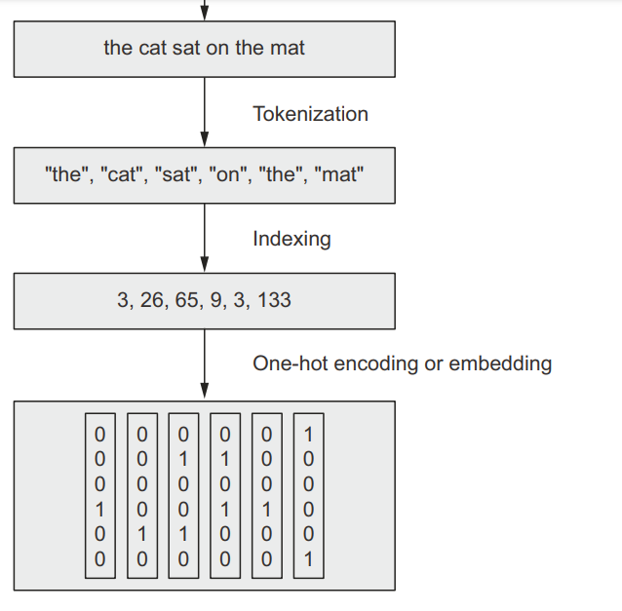
Step 3: Numerical Representation
The next step, which is almost always done immediately after tokenization, is to convert those tokens into numerical representations.
So, this step converts the tokens into numbers.

Slide 90
Step 3: Numerical Representation
Why is Numerical Representation necessary:
Machine learning models (and deep learning models) operate on numbers. They cannot directly process text.
The numerical representation is the bridge between human-readable text and machine-understandable data.
Almost every NLP task, from sentiment analysis to machine translation, requires a numerical representation of text. Without it, we can't apply any machine learning algorithms.

Slide 91
Step 3: Numerical Representation
How does Numerical Representation Works in NLP Projects:
Preprocessing: You'd typically tokenize your text and immediately convert the tokens to numbers (using one of the mentioned in a slide before) before feeding the data to your model.
Model Input: The numerical representation (integer encoded, one-hot encoded, or embeddings) becomes the input to your NLP model.
Model Training: The model learns patterns in these numbers, which correspond to patterns in the original text.

Slide 92
Step 3: Numerical Representation
There are several ways to do this:
Word Embeddings (aka Word Vectors) which uses techniques like Word2Vec, GloVe, FastText, BERT, or by creating an embedding layer and training (i.e creating your model to be used for embedding).
One-Hot Encoding
Vocabulary and Integer Encoding

Slide 93
Step 3: Numerical Representation
Vocabulary and Integer Encoding
This method of Numerical Representation convert token to numbers in three steps
Build a Vocabulary: Create a list of all unique tokens in your training data. This list is your vocabulary.
"The cat sat on the mat. The dog barked."
becomes
["the", "cat", "sat", "on", "mat", ".", "dog", "barked"]
NB: Notice that the word the appeared just once in the generated list called Vocabulary

Slide 94
Step 3: Numerical Representation
b) Integer Encoding: Assign a unique integer to each token in the vocabulary.
i.e: The == 0, cat == 1, sat == 2, on == 3, mat == 4, . == 5, dog == 6, barked == 7
c) Convert Tokens to Integers: Replace each token in your tokenized text with its corresponding integer ID from the vocabulary.
i.e [0, 1, 2, 3, 0, 4, 5, 0, 6, 7]

Slide 95
Step 3: Numerical Representation
Example: Let's say the sentence is "The cat sat on the mat. The dog barked.“.
Stage 1: Vocabulary is: ["the", "cat", "sat", "on", "mat", ".", "dog", "barked"]
Stage 2: The == 0, cat == 1, sat == 2, on == 3, mat == 4, . == 5, dog == 6, barked == 7
Stage 3: encoded token to integer becomes: [0, 1, 2, 3, 0, 4, 5, 0, 6, 7]
NB: The "The" and "the" are normally considered different tokens (unless you do lowercasing first, which was expected to have been done in this regard).
Each word is assigned a unique integer ID. Again, simple, but doesn't capture semantic relationships. Often used as a preliminary step, especially for word embeddings.

Slide 96
Step 3: Numerical Representation
The Vocabulary and Integer Encoding method is simple to implement and understand, but doesn't capture semantic relationships, therefore not so used in the industry like the other two methods.

Slide 97
Step 3: Numerical Representation
One-Hot Encoding: This is a traditional approach to encoding natural language numerically for processing it with a machine.
In this approach, the words of natural language in a sentence (e.g., “the,” “bat,” “sat,” “on,” “the,” and “cat”) are represented by the columns of a matrix. Each row in the matrix, meanwhile, represents a unique word.
If there are 100 unique words across the corpus of documents you’re feeding into your natural language algorithm, then your matrix of one-hot-encoded words will have 100 rows.
If there are 1,000 unique words across your corpus, then there will be 1,000 rows in your one-hot matrix, and so on.

Slide 98
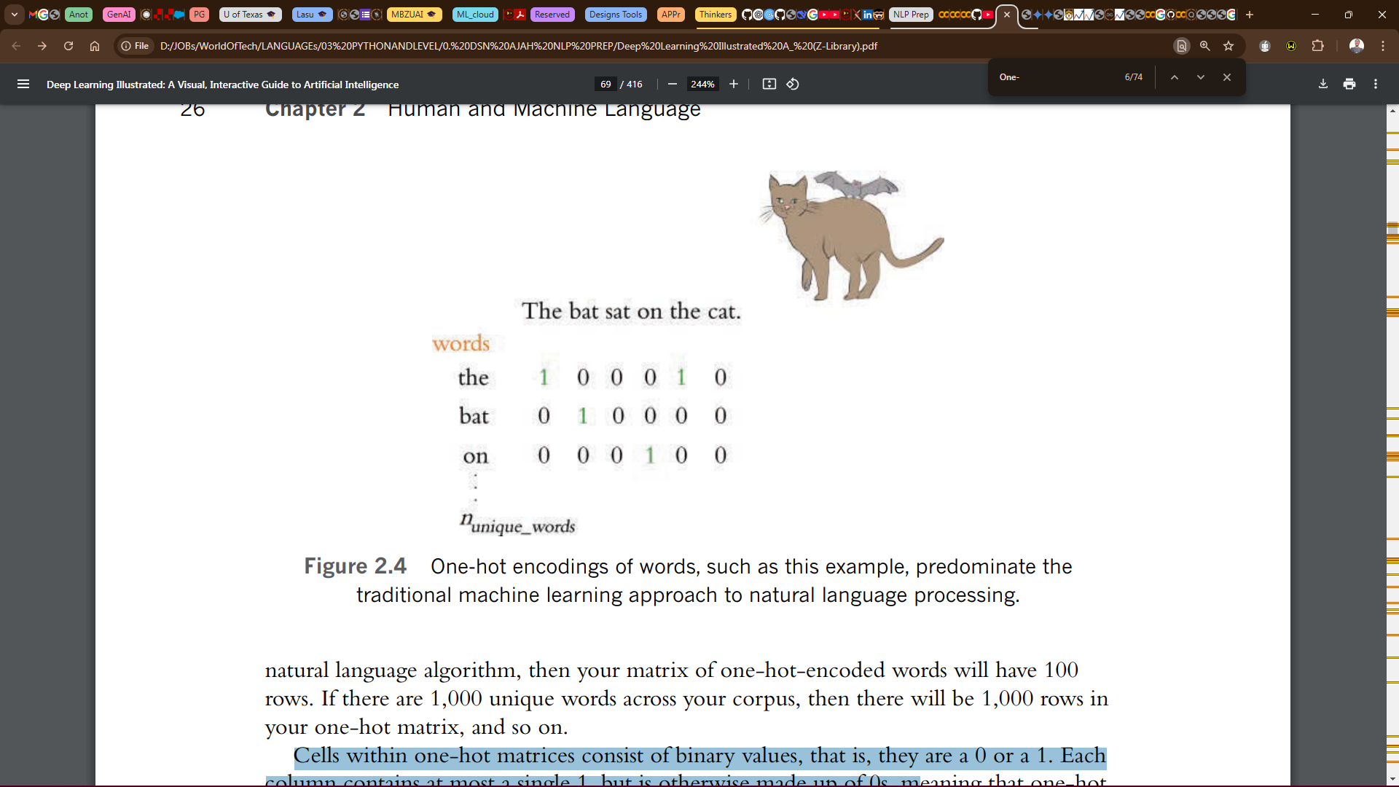
Step 3: Numerical Representation
Cells within one-hot matrices consist of binary values, that is, they are a 0 or a 1.
Each column contains at most a single 1, but is otherwise made up of 0s.
In this example, the entire corpus has only six words, five of which are unique.

Slide 99
Step 3: Numerical Representation
One-hot word representations like this are fairly straightforward, and they are an acceptable format for feeding into a deep learning model (or, indeed, other machine learning models).
However, the simplicity and sparsity of one-hot representations are limiting when incorporated into a natural language application.
It’s can be used for simpler NLP tasks or as a basic representation. It’s also simple but doesn't capture semantic relationships and therefore not the best option for major NLP projects.

Slide 100
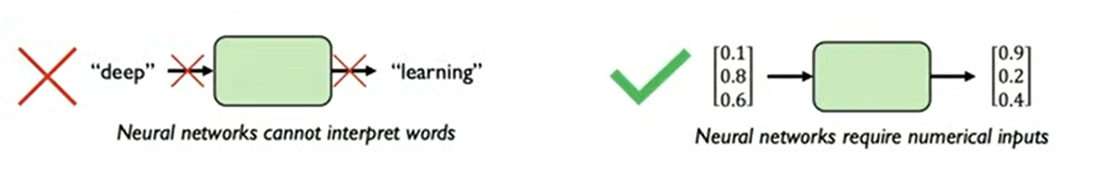
Step 3: Numerical Representation: Word Embedding
Word Embeddings (aka Word Vectors): a specific and powerful type of numerical representation designed to capture semantic meaning.
Vector representations of words are the information-dense alternative to one-hot encodings of words. Whereas one-hot representations capture information about word location only, word vectors (also known as word embeddings or vector-space embeddings) capture information about word meaning as well as location.

Slide 101
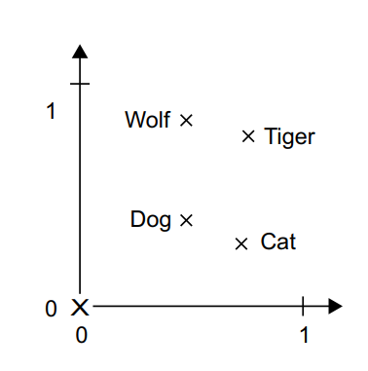
Step 3: Numerical Representation: Word Embedding
Canine== dog like, with pointy tooth btw incisors. FELINE == cat like,
The key advantage, word vectors enable deep learning NLP models to automatically learn linguistic features.
For instance, four words are embedded on a 2D plane: cat, dog, wolf, and tiger.
The same vector allows us to go from cat to tiger and from dog to wolf. This vector could be interpreted as the “from pet to wild animal” vector.
Similarly, another vector lets us go from dog to cat and from wolf to tiger, which could be interpreted as a “from canine to feline” vector.

Slide 102
Step 3: Numerical Representation: Word Embedding
In real-world word-embedding spaces, common examples of meaningful geometric transformations are “gender” vectors and “plural” vectors.
For instance, by adding a “female” vector to the vector “king,” we obtain the vector “queen.”
By adding a “plural” vector, we obtain “kings.”
Remember one-hot encoding? It tells us where a word is in a list, but it doesn't tell us anything about its meaning. It's like having a list of cities but no map to show how they're related

Slide 103
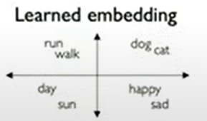
Step 3: Numerical Representation: Word Embedding
So basically, Word Embedding converts the words into number such that, things that are related to each other in language, should numerically be similar and close to each other in the space and things that are very dissimilar should numerically dissimilar and far from away in the space.

Slide 104
Step 3: Numerical Representation: Word Embedding
There are two ways to obtain word embeddings:
Learn word embeddings jointly with the main task you care about (such as document classification or sentiment prediction). In this setup, you start with random word vectors and then learn word vectors in the same way you learn the weights of a neural network.
Load into your model word embeddings that were precomputed using a different machine learning task than the one you’re trying to solve. These are called pretrained word embeddings. They include Word2Vec, GloVe, FastText, BERT. Word2Vec, GloVe, are most popular.
Weights of a neural neural??? Should I explain???

Slide 105
Step 3: Numerical Representation: Word Embedding
Keras is a framework like Tensorflow but lightweight
Why should we learn (abi create) a new embedding space with every new task create out word embedding?
Because, what makes a good word-embedding space depends heavily on your task
The perfect word-embedding space for an English-language movie-review sentiment-analysis model may look different from the perfect embedding space for an English-language legal-document classification model, because the importance of certain semantic relationships varies from task
It’s thus reasonable to learn a new embedding space with every new task.
Fortunately, backpropagation makes this easy, and Keras makes it even easier. It’s about learning the weights of a layer.

Slide 106
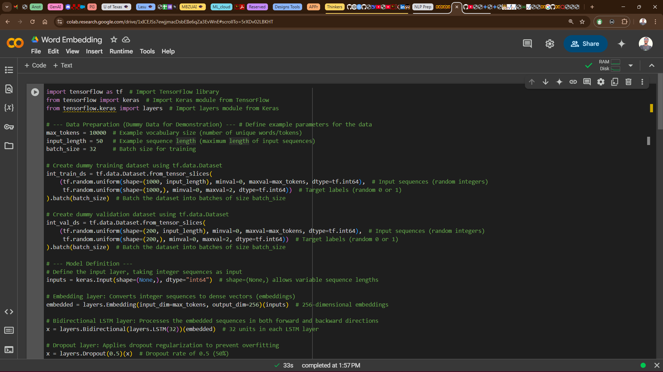
Step 3: Numerical Representation: Word Embedding
Keras is a framework like Tensorflow but lightweight
Learning (abi creating) a new embedding space.
Instantiating an Embedding layer
embedding_layer = layers.Embedding(input_dim=max_tokens, output_dim=256)
The Embedding layer takes at least two arguments, max_token & output_dim.
Parameters: a) input_dim: The number of unique tokens in your vocabulary (the size of your "word list").
b) output_dim: The dimensionality of the embeddings (how many numbers to represent each word).

Slide 107
Step 3: Numerical Representation: Word Embedding
In summary, we created a dummy training dataset and dummy validation dataset,
Understand that the dummy generated dataset are random integers which serves as tokenized dataset, therefore, I could move directly into the embedding layer for word embedding

Slide 108
Step 3: Numerical Representation: Word Embedding
Why should be use pretrained word embeddings?
They are trained on massive datasets.
Capture a lot of semantic information.
Save training time.
Pretrained word embedding techniques include: Word2Vec, Global Vectors for Word Representation (GloVe), FastText, BERT and others.
Word2Vec, GloVe, are most popular.
NB

Slide 109
Step 3: Numerical Representation: Word Embedding
Word2Vec developed by Tomas Mikolov at Google in 2013.
Word2Vec learns by looking at the words surrounding each target word. It tries to predict the context.
Word2Vec dimensions capture specific semantic properties, such as gender.
NB

Slide 110
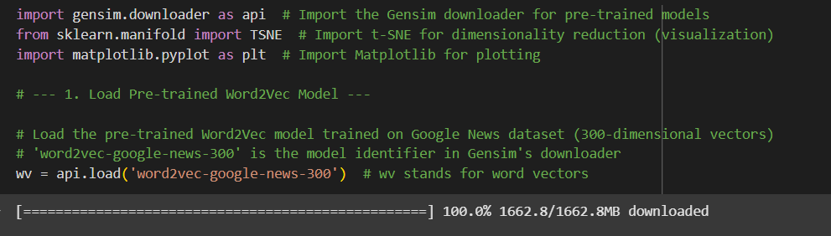
Step 3: Numerical Representation: Word Embedding
To Use Word2Vec:
Load the model
NB: Loading the data should take about 2gb of data.

Slide 111
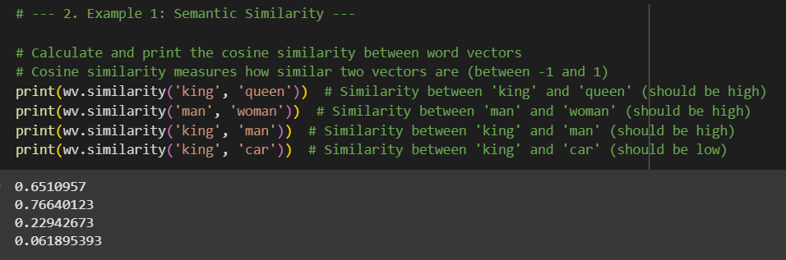
Step 3: Numerical Representation: Word Embedding
To Use Word2Vec:
Apply the model to some text:
As seen, similarity btw king and car is LOW

Slide 112
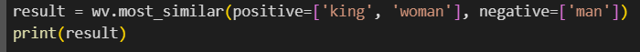
Step 3: Numerical Representation: Word Embedding
As seen, similarity btw king and car is LOW
To Use Word2Vec:
Let’s give an analogy, Find words most similar to 'king' + 'woman' - 'man’. (This should be close to 'queen’)
RESULT: [('queen', 0.7118193507194519), ('monarch', 0.6189674139022827), ('princess', 0.5902431011199951), ('crown_prince', 0.5499460697174072), ('prince', 0.5377321839332581), ('kings', 0.5236844420433044), ('Queen_Consort', 0.5235945582389832), ('queens', 0.5181134343147278), ('sultan', 0.5098593831062317), ('monarchy', 0.5087411999702454)]
This demonstrates the ability of Word2Vec to solve analogy problems

Slide 113
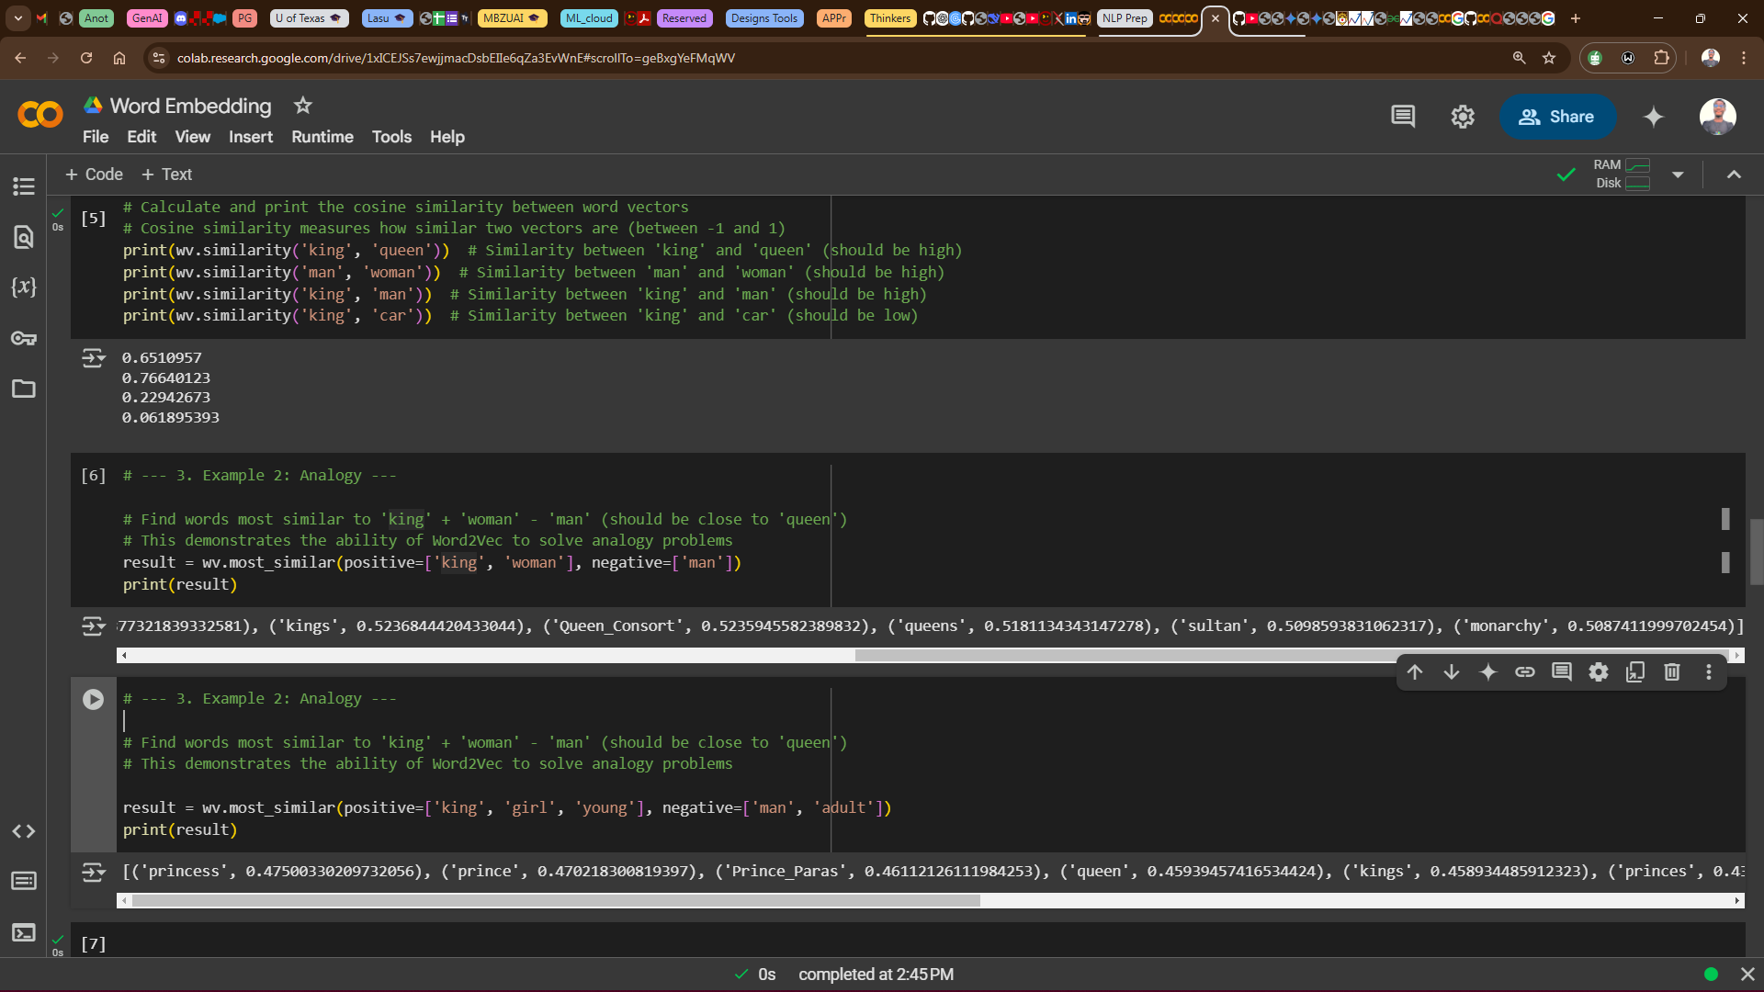
Step 3: Numerical Representation: Word Embedding
To Use Word2Vec:
Let’s give another analogy,
Find words most similar to 'king’ + girl’ + ‘young’ - 'man’ – ‘adult’.
What could this be??
Prince? King child? Princes? Prince_Paras???

Slide 114
Step 3: Numerical Representation: Word Embedding
A Princess!!
Because, A princess relates to a king, is a girl, is young, is not a man, and not an adult.
As seen, princess has the highest.

Slide 115
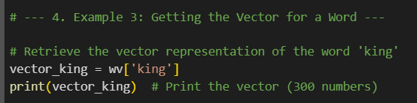
Step 3: Numerical Representation: Word Embedding
To Use Word2Vec:
To get the vector for a word:

Slide 116
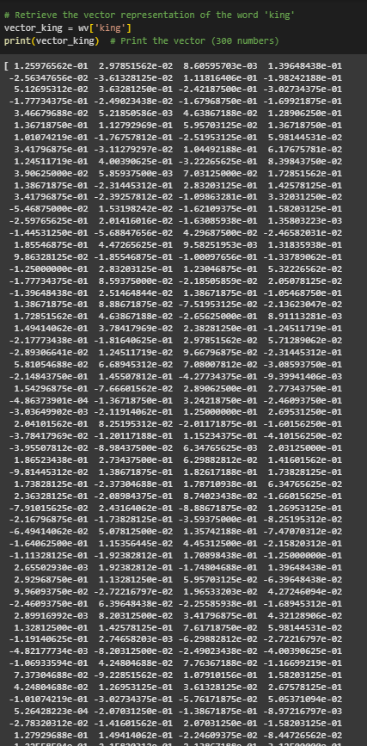
👉
The Vector for the word KING is:

Slide 117
Step 3: Numerical Representation: Word Embedding
The Vector for the word KING is:
[ 1.25976562e-01 2.97851562e-02 8.60595703e-03 1.39648438e-01 -2.56347656e-02 -3.61328125e-02 1.11816406e-01 -1.98242188e-01 5.12695312e-02 3.63281250e-01 -2.42187500e-01 -3.02734375e-01 -1.77734375e-01 -2.49023438e-02 -1.67968750e-01 -1.69921875e-01 3.46679688e-02 5.21850586e-03 4.63867188e-02 1.28906250e-01 1.36718750e-01 1.12792969e-01 5.95703125e-02 1.36718750e-01 1.01074219e-01 -1.76757812e-01 -2.51953125e-01 5.98144531e-02 3.41796875e-01 -3.11279297e-02 1.04492188e-01 6.17675781e-02 1.24511719e-01 4.00390625e-01 -3.22265625e-01 8.39843750e-02 3.90625000e-02 5.85937500e-03 7.03125000e-02 1.72851562e-01 1.38671875e-01 -2.31445312e-01 2.83203125e-01 1.42578125e-01 3.41796875e-01 -2.39257812e-02 -1.09863281e-01 3.32031250e-02 -5.46875000e-02 1.53198242e-02 -1.62109375e-01 1.58203125e-01 -2.59765625e-01 2.01416016e-02 -1.63085938e-01 1.35803223e-03 -1.44531250e-01 -5.68847656e-02 4.29687500e-02 -2.46582031e-02 1.85546875e-01 4.47265625e-01 9.58251953e-03 1.31835938e-01 9.86328125e-02 -1.85546875e-01 -1.00097656e-01 -1.33789062e-01 -1.25000000e-01 2.83203125e-01 1.23046875e-01 5.32226562e-02 -1.77734375e-01 8.59375000e-02 -2.18505859e-02 2.05078125e-02 -1.39648438e-01 2.51464844e-02 1.38671875e-01 -1.05468750e-01 1.38671875e-01 8.88671875e-02 -7.51953125e-02 -2.13623047e-02 1.72851562e-01 4.63867188e-02 -2.65625000e-01 8.91113281e-03 1.49414062e-01 3.78417969e-02 2.38281250e-01 -1.24511719e-01 -2.17773438e-01 -1.81640625e-01 2.97851562e-02 5.71289062e-02 -2.89306641e-02 1.24511719e-02 9.66796875e-02 -2.31445312e-01 5.81054688e-02 6.68945312e-02 7.08007812e-02 -3.08593750e-01 -2.14843750e-01 1.45507812e-01 -4.27734375e-01 -9.39941406e-03 1.54296875e-01 -7.66601562e-02 2.89062500e-01 2.77343750e-01 -4.86373901e-04 -1.36718750e-01 3.24218750e-01 -2.46093750e-01 -3.03649902e-03 -2.11914062e-01 1.25000000e-01 2.69531250e-01 2.04101562e-01 8.25195312e-02 -2.01171875e-01 -1.60156250e-01 -3.78417969e-02 -1.20117188e-01 1.15234375e-01 -4.10156250e-02 -3.95507812e-02 -8.98437500e-02 6.34765625e-03 2.03125000e-01 1.86523438e-01 2.73437500e-01 6.29882812e-02 1.41601562e-01 -9.81445312e-02 1.38671875e-01 1.82617188e-01 1.73828125e-01 1.73828125e-01 -2.37304688e-01 1.78710938e-01 6.34765625e-02 2.36328125e-01 -2.08984375e-01 8.74023438e-02 -1.66015625e-01 -7.91015625e-02 2.43164062e-01 -8.88671875e-02 1.26953125e-01 -2.16796875e-01 -1.73828125e-01 -3.59375000e-01 -8.25195312e-02 -6.49414062e-02 5.07812500e-02 1.35742188e-01 -7.47070312e-02 -1.64062500e-01 1.15356445e-02 4.45312500e-01 -2.15820312e-01 -1.11328125e-01 -1.92382812e-01 1.70898438e-01 -1.25000000e-01 2.65502930e-03 1.92382812e-01 -1.74804688e-01 1.39648438e-01 2.92968750e-01 1.13281250e-01 5.95703125e-02 -6.39648438e-02 9.96093750e-02 -2.72216797e-02 1.96533203e-02 4.27246094e-02 -2.46093750e-01 6.39648438e-02 -2.25585938e-01 -1.68945312e-01 2.89916992e-03 8.20312500e-02 3.41796875e-01 4.32128906e-02 1.32812500e-01 1.42578125e-01 7.61718750e-02 5.98144531e-02 -1.19140625e-01 2.74658203e-03 -6.29882812e-02 -2.72216797e-02 -4.82177734e-03 -8.20312500e-02 -2.49023438e-02 -4.00390625e-01 -1.06933594e-01 4.24804688e-02 7.76367188e-02 -1.16699219e-01 7.37304688e-02 -9.22851562e-02 1.07910156e-01 1.58203125e-01 4.24804688e-02 1.26953125e-01 3.61328125e-02 2.67578125e-01 -1.01074219e-01 -3.02734375e-01 -5.76171875e-02 5.05371094e-02 5.26428223e-04 -2.07031250e-01 -1.38671875e-01 -8.97216797e-03 -2.78320312e-02 -1.41601562e-01 2.07031250e-01 -1.58203125e-01 1.27929688e-01 1.49414062e-01 -2.24609375e-02 -8.44726562e-02 1.22558594e-01 2.15820312e-01 -2.13867188e-01 -3.12500000e-01 -3.73046875e-01 4.08935547e-03 1.07421875e-01 1.06933594e-01 7.32421875e-02 8.97216797e-03 -3.88183594e-02 -1.29882812e-01 1.49414062e-01 -2.14843750e-01 -1.83868408e-03 9.91210938e-02 1.57226562e-01 -1.14257812e-01 -2.05078125e-01 9.91210938e-02 3.69140625e-01 -1.97265625e-01 3.54003906e-02 1.09375000e-01 1.31835938e-01 1.66992188e-01 2.35351562e-01 1.04980469e-01 -4.96093750e-01 -1.64062500e-01 -1.56250000e-01 -5.22460938e-02 1.03027344e-01 2.43164062e-01 -1.88476562e-01 5.07812500e-02 -9.37500000e-02 -6.68945312e-02 2.27050781e-02 7.61718750e-02 2.89062500e-01 3.10546875e-01 -5.37109375e-02 2.28515625e-01 2.51464844e-02 6.78710938e-02 -1.21093750e-01 -2.15820312e-01 -2.73437500e-01 -3.07617188e-02 -3.37890625e-01 1.53320312e-01 2.33398438e-01 -2.08007812e-01 3.73046875e-01 8.20312500e-02 2.51953125e-01 -7.61718750e-02 -4.66308594e-02 -2.23388672e-02 2.99072266e-02 -5.93261719e-02 -4.66918945e-03 -2.44140625e-01 -2.09960938e-01 -2.87109375e-01 -4.54101562e-02 -1.77734375e-01 -2.79296875e-01 -8.59375000e-02 9.13085938e-02 2.51953125e-01]

Slide 118
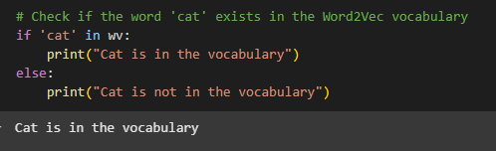
Step 3: Numerical Representation: Word Embedding
To Use Word2Vec:
To check if a word exists in the vocabulary:

Slide 119
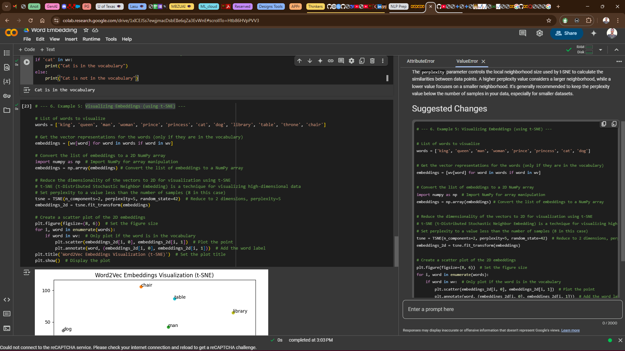
Step 3: Numerical Representation: Word Embedding
To Use Word2Vec: To Visualize Embeddings(using t-SNE):
Visualizing embedding means how close words relates,
Can we guess??

Slide 120
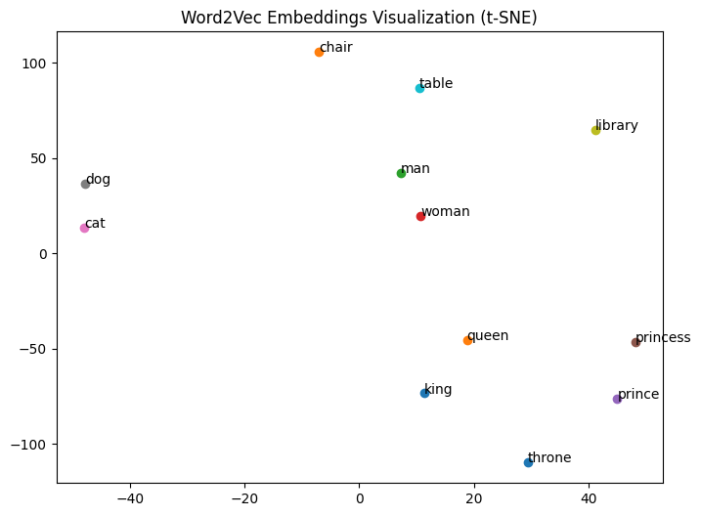
Word2Vec Visualization
words = ['king', 'queen', 'man', 'woman', 'prince', 'princess', 'cat', 'dog', 'library', 'table', 'throne', 'chair']

Slide 121
Step 3: Numerical Representation: Word Embedding
To Use Word2Vec: To Visualize Embeddings(using t-SNE):
List of words to visualize
['king', 'queen', 'man', 'woman', 'prince', 'princess', 'cat', 'dog', 'library', 'table', 'throne', 'chair']
Let’s get this done…..
Can we guess??

Slide 122

Step 3: Numerical Representation: Word Embedding
Waiting!!!!!!!!!
Let’s get this done…..
Can we give a trial??

Slide 123
Step 3: Numerical Representation: Word Embedding
List of words to visualize ['king', 'queen', 'man', 'woman', 'prince', 'princess', 'cat', 'dog', 'library', 'table', 'throne', 'chair’]
Say: Royalty: king, queen, prince, princess
Gender: man, woman
Pets/Animals: cat, dog, kitten, puppy
Books/Reading: book, library, page, author
Furniture: chair, table, furniture, sofa
Right????

Slide 124
List of words to visualize ['king', 'queen', 'man', 'woman', 'prince', 'princess', 'cat', 'dog', 'library', 'table', 'throne', 'chair’]
So, we have….
Interesting right!!

Slide 125
Step 3: Numerical Representation: Word Embedding
GloVe developed by Stanford researchers in 2014.
This embedding technique is based on factorizing a matrix of word co-occurrence statistics.
Its developers have made available precomputed embeddings for millions of English tokens, obtained from Wikipedia data and Common Crawl data.
NB

Slide 126
Step 3: Numerical Representation: Word Embedding
To use the Glove:
First, let’s download the GloVe word embeddings precomputed on the 2014 English Wikipedia dataset. It’s an 822 MB zip file containing 100-dimensional embedding vectors for 400,000 words (or non-word tokens).
Type the code:
!wget http:/ /nlp.stanford.edu/data/glove.6B.zip
!unzip -q glove.6B.zip
NB

Slide 127
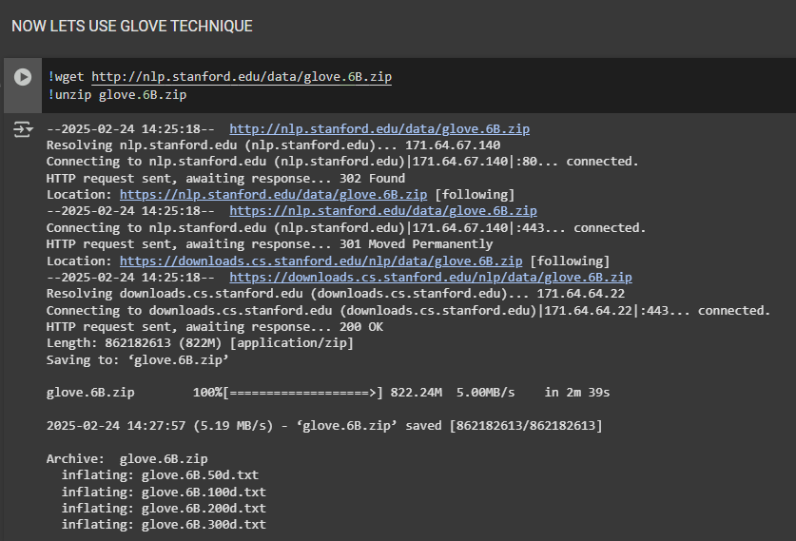
👉 GloVe
To use the Glove:
Downloading GloVe
This about 900mb and another 400mb…..
NB

Slide 128
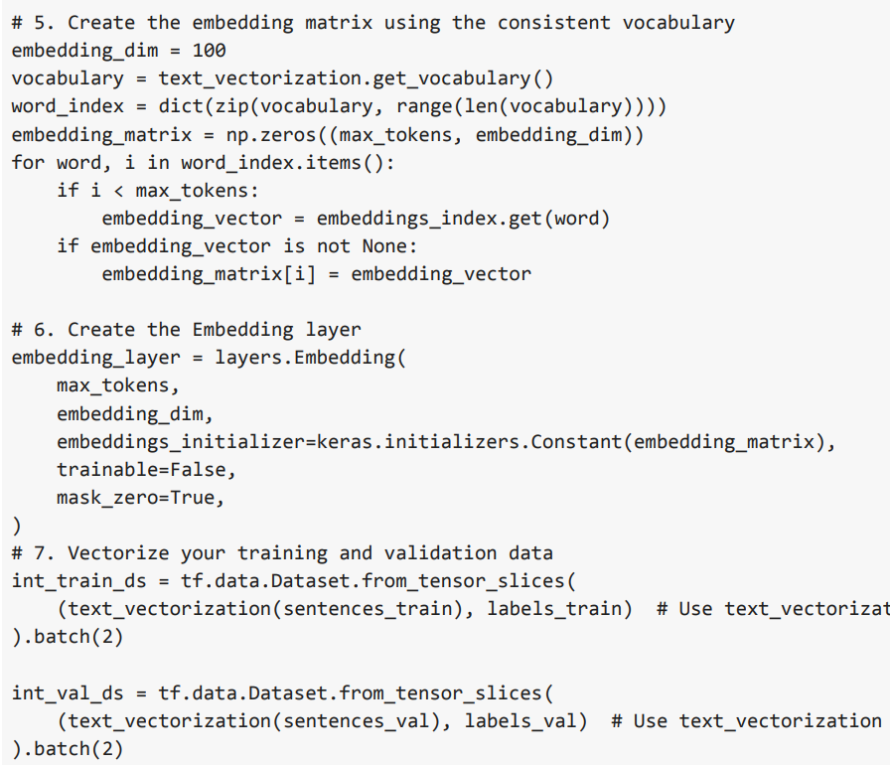
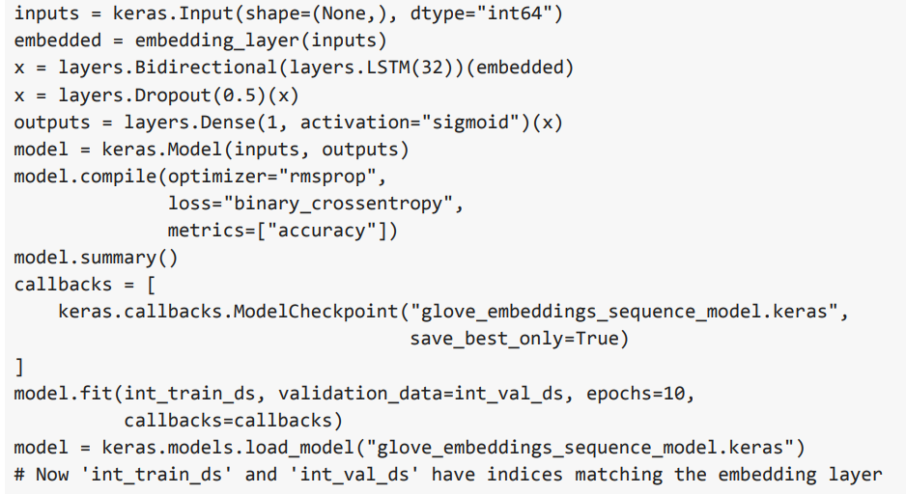
👉 GloVe
Setup some long process which include
Preparing Training and validation sentence
Text Vectorization, embedding, and building the model.
You may need to define some functions you can simply call and pass in it’s parameter/arguments to use the built GloVe Model.
NB: This code snippet by the side isn’t the full code, we can check that out in a colab
NB

Slide 129
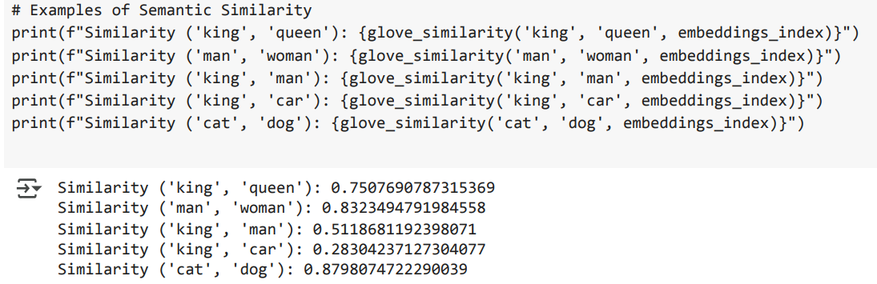
Step 3: Numerical Representation: Word Embedding
To Use GloVe:
To check for semantic similarities:
You see king and car and very little semantic similarities.

Slide 130
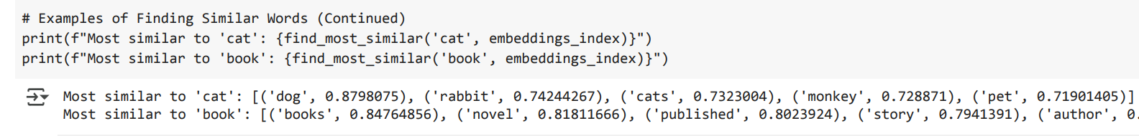
Step 3: Numerical Representation: Word Embedding
To Use GloVe:
To find similar word:
Dog has the most similar word

Slide 131
Step 3: Numerical Representation: Word Embedding
To Use GloVe:
To find similar word:
Dog has the most similar word to Cat

Slide 132
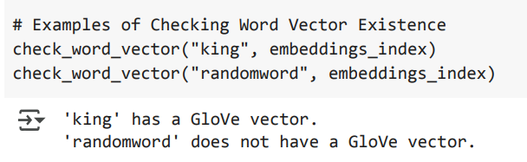
Step 3: Numerical Representation: Word Embedding
To Use GloVe:
To check if specific Word Vector exists:
King exists, randomword doesn't! That’s expected.

Slide 133
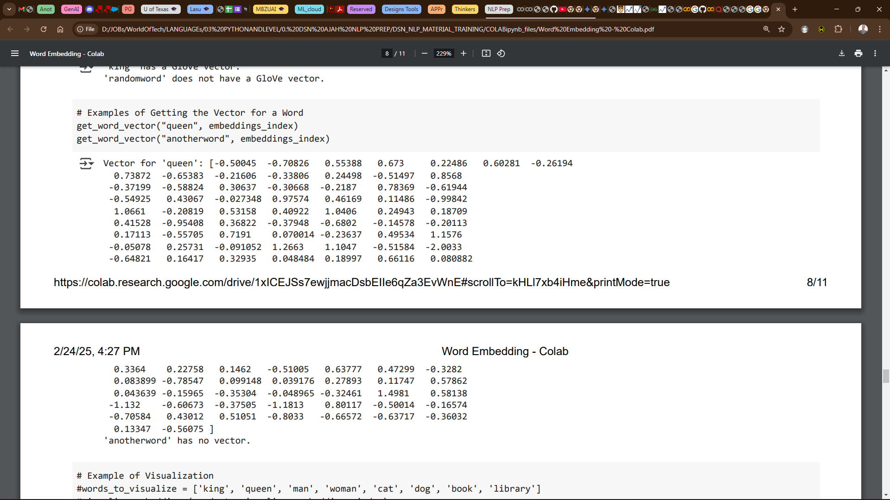
Step 3: Numerical Representation: Word Embedding
To Use GloVe:
To check if specific Word Vector exists:
As seen, Vector for “queen” exists, but no vector for the word “anotherword’
Again, the vectors are in numbers just like it was when we used word2vec

Slide 134
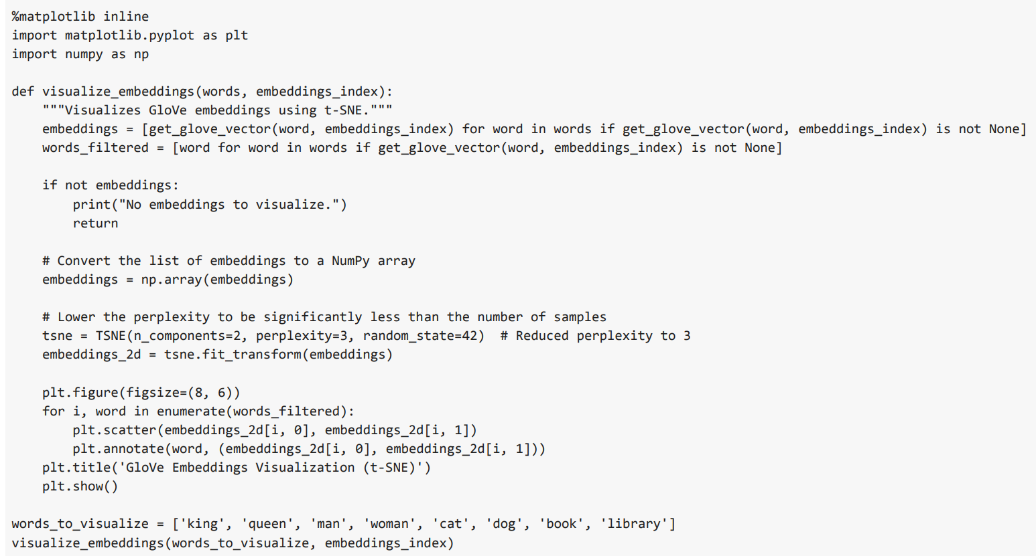
Step 3: Numerical Representation: Word Embedding
To Use GloVe:
To visualize Embeddings (using t-SNE):
The word_to_visualize variable stores the list with the words

Slide 135
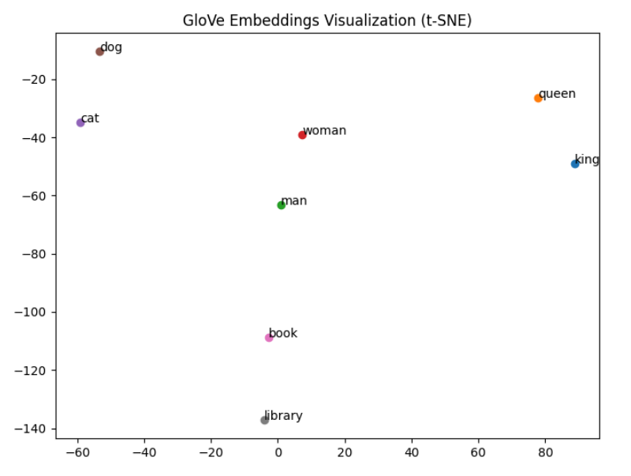
👉 GloVe
To Use GloVe:
To visualize Embeddings (using t-SNE):
words_to_visualize = ['king', 'queen', 'man', 'woman', 'cat', 'dog', 'book', 'library']

Slide 136
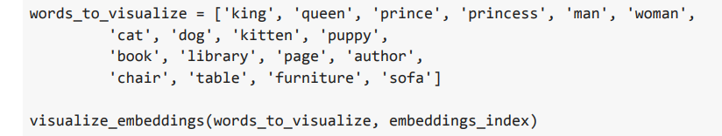
Step 3: Numerical Representation: Word Embedding
To Use GloVe:
To visualize Embeddings (using t-SNE):
words_to_visualize = ['king', 'queen', 'prince', 'princess', 'man', 'woman’, 'cat', 'dog', 'kitten', 'puppy’, 'book', 'library', 'page', 'author’, 'chair', 'table', 'furniture', 'sofa']

Slide 137
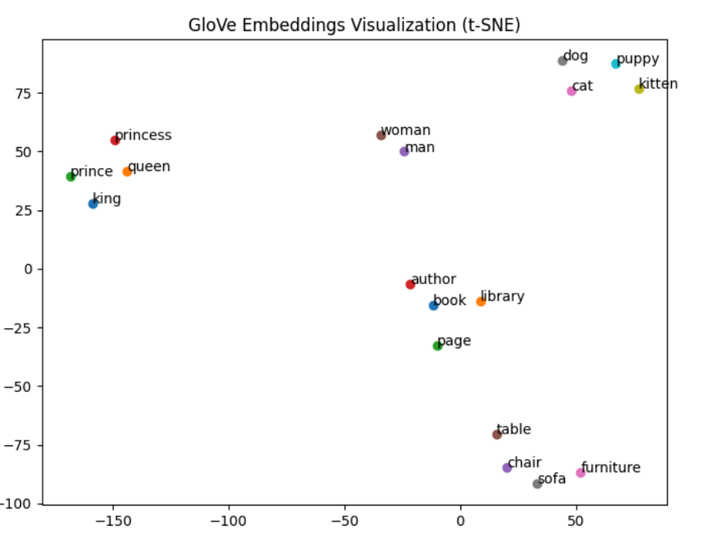
👉 GloVe
To Use GloVe:
To visualize Embeddings (using t-SNE):
words_to_visualize = ['king', 'queen', 'prince', 'princess', 'man', 'woman’, 'cat', 'dog', 'kitten', 'puppy’, 'book', 'library', 'page', 'author’, 'chair', 'table', 'furniture', 'sofa']

Slide 138
What is t-SNE (pronounced tee-snee)
t-distributed stochastic neighbor embedding, t-SNE (pronounced tee-snee), simply used for plotting word vector.
It was developed by Laurens van der Maaten in collaboration with Geoff Hinton.
t-SNE allow us to use the dimensionality reduction to approximately map the locations of words from high dimensional word-vector space down to two or three dimensions.

Slide 139
Word2Vec vs GloVe
FEATURE | WORD2VEC | GLOVE
Learning Method | "Guess the Neighbors" (Predictive) | "Count the Co-occurrences" (Statistical)
How It Works | Tries to predict nearby words in a sentence. | Analyzes how often words appear together in the whole text.
Focus | Local context (words close together) | Global statistics (overall word relationships)
Analogy | "Gossip Network" (learns from nearby "friends") | "Census Taker" (counts co-occurrences like neighbors)
Strength | Captures subtle semantic relationships. | Captures general word similarity and relatedness.
Example Use | Understanding "run" in different contexts (exercise vs. program). | Knowing "cat" and "dog" are generally similar animals.
Key Idea | Learns by predicting what words go together in a sentence. | Learns by counting how often words appear together in a large text.
Think of It As | Learning from the immediate surrounding words. | Learning from the entire collection of words.

Slide 140

Numerical Representation: Word Embedding
FastText: Developed by facebook’s AI Research lab (meta) in 2015
It’s the contemporary leading alternative to both word2vec and GloVe, Designed to address their limitations, particularly in handling rare words and morphologically rich languages (as in word2vec).
FastText can understand that 'unbreakable' is related to 'break' even if it hasn't seen 'unbreakable' before.
It considers subword information, making it effective for morphologically rich languages and handling out-of-vocabulary words.
This enables fastText to work around some of the issues related to rare words and out-of-vocabulary words addressed in the preprocessing section at the outset of this chapter.

Slide 141
Step 3: Numerical Representation: Word Embedding
BERT (bi-directional encoder representations from transformers):
BERT was developed by Google and introduced in 2018.
It revolutionized NLP with its ability to understand context deeply.
It's based on the Transformer architecture, which uses attention mechanisms.
Unlike Word2Vec and GloVe, which are unidirectional or consider context in a limited way, BERT is trained bidirectionally.
This means it considers the context of a word from both the left and right sides, leading to a much richer understanding.
What’s Attention Mechanism???
What are transformers???

Slide 142
Step 3: Numerical Representation: Word Embedding
Because BERT is Transformer Based, we need to understand a new topic called Attention Mechanism and Transformers first.
For now, understand that, considering Architecture, Word2Vec and GloVe are simpler models. BERT is a deep Transformer-based model.
Also, Unlike Word2Vec and GloVe, which are unidirectional or consider context in a limited way, BERT is trained bidirectionally.
This means it considers the context of a word from both the left and right sides, leading to a much richer understanding.
Yaa, Let’s wait till then,
Meanwhile, before then, DYOR

Slide 143
Pre-Trained Model for Word Embedding history
Recap:
Word2Vec = 2013
Glove = 2014
FastText = 2015
BERT = 2018

Slide 144
The END
DSN LEKKI-AJAH
BY ABEREJO HABEEBLAH O.
X: @haberejo
Day 3

Slide 145
NATURAL LANGUAGE PROCESSING (NLP) TRANSFORMERS AND ATTENTION
DSN LEKKI-AJAH
BY ABEREJO HABEEBLAH O.
X: @haberejo
Day 4

Slide 146
What’s Next 😃😃
Maybe I don’t know also!!!
If Yes, 😃😃
Let’s move back a bit!!

Slide 147
Understand Human Language
There are arguably 3 steps to help computer understand human texts,
Text Preprocessing
Tokenization
Numerical Representation (Word Embedding)
Now, Lets discuss each further!!
Remember this?
We’ve explained the 3 steps…..
Whats next in NLP?
Can we now build our ChatGPT?

Slide 148
What’s Next 😃😃
I remembered something
How about
Transformers ??
and
Attention ??

Slide 149
Transformers: Attention is All You Need
A transformer is a type of artificial intelligence model that learns to understand and generate human-like text by analyzing patterns in large amounts of text data
Transformers are a revolutionary type of neural network that rely entirely on something called attention.
They process all the words at the same time, making them much faster than RNNs (Recurrent Neural Networks).
We Move!!!!

Slide 150
What do you notice😃😃
We have mentioned RNNs (Recurrent Neural Network) severally with minimal explanation
RNN, let’s discuss briefly

Slide 151
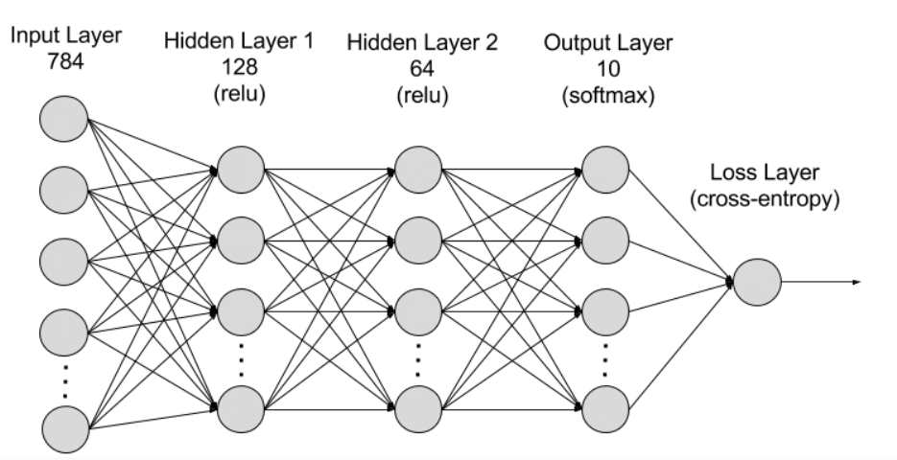
Recurrent Neural Networks (RNNs)
Recurrent neural networks (RNNs) is a family of deep learning models that can handle long sequences of data.
The family include specialized layer types like long short-term memory units (LSTMs) and gated recurrent units (GRUs).
Sequential data is data, such as words, sentences, or time-series data, where sequential components interrelate based on complex semantics and syntax rules.

Slide 152
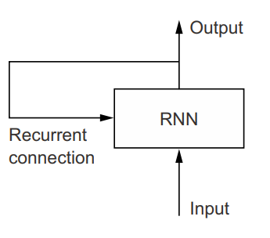
Recurrent Neural Networks (RNNs)
In effect, an RNN is a type of neural network that has an internal loop, hence, Recurrent Neural Network.
In simple terms; an RNN is a for loop that reuses quantities computed during the previous iteration of the loop.
A recurrent network:
a network with a loop

Slide 153
Recurrent Neural Networks (RNNs)
RNNs maintain a hidden state that acts as a form of memory.
At each time step, the hidden state is updated based on the current input and the previous hidden state.
This allows the network to capture dependencies and patterns across the sequence, though forgetting captured information from the very beginning of a long Sentence.

Slide 154
Types of RNN Architectures:
Simple RNNs (Vanilla RNNs): The basic form of RNNs. Prone to vanishing and exploding gradient problems.
Long Short-Term Memory (LSTM) Networks: Designed to address the vanishing gradient problem. Use "gates" to control the flow of information in the hidden state. Better at capturing long-range dependencies.
Gated Recurrent Unit (GRU) Networks: A simplified version of LSTMs. Also uses gates to control information flow. Often performs comparably to LSTMs with fewer parameters.
Bidirectional RNNs: Process sequences in both forward and backward directions. Useful for tasks where context from both past and future is important.
Deep RNNs: Stack multiple RNN layers on top of each other. Allow the network to learn more complex representations.

Slide 155
Bottleneck of RNNs
RNNs have trouble dealing with very long sequences, as they tend to progressively forget about the past.
By the time you’ve reached the 100th token in either sequence, little information remains about the start of the sequence.
That means RNN-based models can’t hold onto long-term context, which can be essential for translating long documents.

Slide 156
Addressing Limitations:
Attention Mechanisms which allow the model to focus on relevant parts of the input sequence.
Transformers which replaces recurrence with attention mechanisms, enabling parallel processing.
Using LSTMs and GRUs which uses gating mechanisms to control information flow.
Don’t get confused, and Transformers are a model, Attention is a component that can be used in any Neural Network like CNN.
This limitation is what has led the ML community to embrace the Transformer architecture for sequence-to-sequence problems

Slide 157
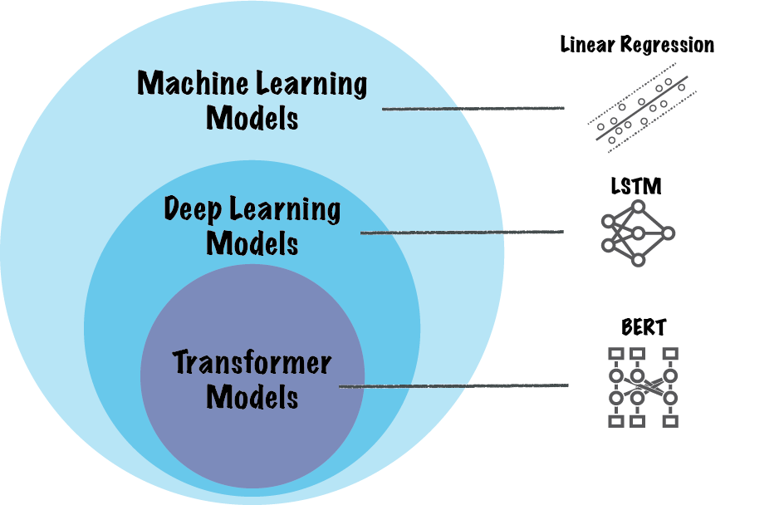
Transformers: Attention is All You Need
So now, let’s redefine Transformers,
Transformers is a type of Neural Network architecture that is built on ATTENTION as its foundational mechanism. e.g BERT, GPT.

Slide 158
Transformers: Attention is All You Need
Transformers are a revolutionary type of neural network that rely entirely on something called attention.
Transformers are based entirely on attention mechanisms, eliminating recurrence like in RNN.
Unlike RNN that analyze words one by one, Transformers read all the words at the same time.
Time to now explain Attention better

Slide 159
Attention
Attention is a technique that allows a neural network to focus on specific parts of an input sequence when processing it.
They enable the model to weigh the importance of different input elements, giving more "attention" to the most relevant ones.
Think of it as a way for the model to selectively focus on the most important information.

Slide 160
Attention
Helps us attend to the most important parts of an input by
1. Identify which parts to attend to
2. Extract the features with high attention

Slide 161
Attention Mechanism (Queries, Keys, Values)
Attention mechanisms

Slide 162
Bottleneck of RNNs
SEQ2SEQ PG 358 OF Deep Learning with Python

Slide 164
Step 2: Tokenization
There are different types of tokenization:
Sentence Tokenization (Sentence-Level Tokenization): Splits text into individual sentences. Important for tasks like text summarization or machine translation.Example: "The cat sat on the mat. The dog barked." becomes ["The cat sat on the mat.", "The dog barked."]Splitting text into sentences. Using the .sent_tokenize() method
Word Tokenization (Word-Level Tokenization): Splits text into individual words. This is the most common type.
Example: "The cat sat on the mat." becomes ["The", "cat", "sat", "on", "the", "mat", "."]. Using the .word_tokenize() method
Subword Tokenization: This involves using a transformer-based tokenizer like (BPE - Byte Pair Encoding), WordPiece).
Word-level Tokenization:

Slide 165

Step 2: Tokenization
What is Tokenization?Tokenization is the process of splitting a text into individual units, called tokens. These tokens can be words, subwords, characters, or even punctuation marks. It's the first step in most NLP pipelines, as it prepares the text for further processing.Tokenization: Tokenization is the process of breaking text into individual units (tokens).
There are different types of tokenization:
- Sentence Tokenization (aka Sentence-Level Tokenization): Splitting text into sentences. Using the .sent_tokenize()method
- Word Tokenization (aka Word-Level Tokenization): is splitting text into words. Using the .word_tokenize()method
- Subword Tokenization: This involves using a transformer-based tokenizer like (BPE [Byte Pair Encoding], WordPiece).
The Quick! bRoWn foX juMPS.
the quick! brown fox jumps.
NB:
Corpus in this regard means collection of writings.

Slide 166
A Glossary of Essential AI/ML/DL/NLP Terminologies
This is a PLUS +
General AI Terms are:
Artificial Intelligence (AI): The broad concept of creating machines that can perform tasks that usually require human intelligence. Simple: Making computers smart like us. Scenario: Imagine a robot that can cook dinner, do laundry, and even hold a conversation.
Agent: An entity (software or hardware) that perceives its environment and acts to achieve a goal. Simple: Something that can see what's around it and make decisions to do something. Scenario: Think of a video game character. It sees the game world (environment) and you control it to jump, shoot, etc. (actions) to win the game (goal).

Slide 167
A Glossary of Essential AI/ML/DL/NLP Terminologies
This is a PLUS +
Machine Learning (ML): A subset of AI where machines learn from data without being explicitly programmed. Simple: Teaching a computer to learn by showing it examples, like training a dog with treats. Scenario: A music app recommending songs you might like. It learns your taste based on what you've listened to before.
Deep Learning (DL): A subfield of ML using artificial neural networks with many layers to learn complex patterns. Simple: A really complex way of teaching a computer, like how our brains learn with lots of interconnected parts. Scenario: Image recognition software that can tell the difference between a cat and a dog, even if they look similar.
Natural Language Processing (NLP): A branch of AI focused on enabling computers to understand, interpret, and generate human language. Simple: Teaching computers to understand and talk like us. Scenario: Google Translate, which can translate text from one language to another.

Slide 168
A Glossary of Essential AI/ML/DL/NLP Terminologies
This is a PLUS +
Machine Learning Terms:
Supervised Learning: Learning from labeled data (input-output pairs). Simple: Teaching a computer with answer keys. Scenario: Training a program to predict house prices. You give it examples of houses with their sizes, locations, and prices (the "answer key").
Unsupervised Learning: Learning from unlabeled data, finding patterns. Simple: Giving a computer a bunch of stuff and asking it to sort it into groups. Scenario: A website suggesting groups you might like to join based on your interests.
Reinforcement Learning: An agent learns by interacting with an environment and getting rewards or penalties. Simple: Training a pet with positive and negative reinforcement. Scenario: An AI playing a video game. It gets points for winning and loses points for losing, learning to play better over time.
Training Data: The data used to train a model. Simple: The examples you show the computer to learn from. Scenario: All the photos of cats and dogs you use to train the image recognition software.
Test Data: Data used to check how well the trained model performs on new data. Simple: Showing the computer pictures it hasn't seen before to see if it learned correctly. Scenario: Using a different set of cat and dog photos to test the image recognition software.
Feature: A measurable characteristic. Simple: A detail about something. Scenario: In predicting house prices, features are size, location, number of rooms, etc.
Model: A mathematical representation of learned patterns. Simple: The rules the computer learns. Scenario: The formula the computer uses to predict house prices.
Algorithm: The specific set of rules or instructions used for learning. Simple: The method the computer uses to learn. Scenario: Different ways of training a computer, like different study techniques.
Overfitting: A model that learns the training data too well (including noise) and performs poorly on test data. Simple: Memorizing the answers to practice questions but failing the real test. Scenario: A model that can perfectly predict prices of houses it has seen, but it can't predict prices of houses it has not seen.
Underfitting: A model that is too simple to capture the patterns and performs poorly on both training and test data. Simple: Not studying enough and failing the test. Scenario: A model that is too simple to predict house prices.Accuracy: How often the model makes correct predictions. Simple: How often the computer gets the answer right.Precision: Out of all positive predictions, how many were actually positive? Simple: Of all the things the computer said were cats, how many were actually cats?Recall: Out of all actually positive cases, how many did the model correctly identify? Simple: Of all the actual cats, how many did the computer correctly identify?Bias: Systematic error in the model due to flawed assumptions. Simple: A prejudice in the computer's thinking. Scenario: A model trained only on pictures of sunny days will be biased and might not recognize cloudy days.Variance: Sensitivity of the model to fluctuations in the training data. Simple: The computer getting confused by small changes in the examples. Scenario: A model that works perfectly on one set of data but fails on another very similar set of data.Hyperparameters: Parameters set before training that control the learning process. Simple: Settings you adjust before you start training. Scenario: Like adjusting the focus and brightness on a camera before taking a picture.Deep Learning Terms:Neural Network: Interconnected layers of neurons that process information. Simple: A network of connected "brains" working together.Neuron (Node): A basic processing unit in a neural network. Simple: A single "brain" in the network.Layer: A group of neurons (input, hidden, output layers). Simple: A level in the network.Activation Function: Introduces non-linearity to neurons. Simple: A way for the "brains" to make more complex decisions.Backpropagation: Adjusting connection weights to minimize prediction errors. Simple: A way for the network to learn from its mistakes.Epoch: One complete pass through the entire training dataset. Simple: Showing the computer all the examples once.Batch Size: Number of training examples processed at once. Simple: How many examples the computer looks at at a time.Optimization Algorithm: Used to adjust model parameters. Simple: The method the computer uses to learn.Loss Function: Measures the model's prediction error. Simple: How the computer knows it made a mistake.Weight: The strength of the connection between two neurons. Simple: How strongly two "brains" influence each other.Learning Rate: How quickly the model updates its weights. Simple: How quickly the computer learns.Natural Language Processing Terms:Tokenization: Breaking down text into tokens (words, phrases). Simple: Splitting a sentence into words.Stop Words: Common words (e.g., "the," "a," "is") often removed. Simple: Words that don't carry much meaning.Stemming: Reducing words to their root form. Simple: Chopping off the endings of words.Lemmatization: Reducing words to their dictionary form (lemma). Simple: Finding the base word.Word Embeddings: Representing words as vectors capturing semantic relationships. Simple: Giving each word a set of coordinates in "meaning-space."Sentiment Analysis: Determining the emotional tone of text. Simple: Figuring out if someone is happy or sad based on what they wrote.Machine Translation: Translating text from one language to another.Text Summarization: Generating a concise summary of text.Named Entity Recognition (NER): Identifying and classifying named entities. Simple: Finding and labeling names of people, places, and organizations.Corpus: A large collection of text. Simple: A big library of text.
Binary Language == 1 and 0

Slide 169
A Glossary of Essential AI/ML/DL/NLP Terminologies
This is a PLUS +
Machine Learning Terms:
Supervised Learning: Learning from labeled data (input-output pairs). Simple: Teaching a computer with answer keys. Scenario: Training a program to predict house prices. You give it examples of houses with their sizes, locations, and prices (the "answer key").
Unsupervised Learning: Learning from unlabeled data, finding patterns. Simple: Giving a computer a bunch of stuff and asking it to sort it into groups. Scenario: A website suggesting groups you might like to join based on your interests.
Reinforcement Learning: An agent learns by interacting with an environment and getting rewards or penalties. Simple: Training a pet with positive and negative reinforcement. Scenario: An AI playing a video game. It gets points for winning and loses points for losing, learning to play better over time.

Slide 170
A Glossary of Essential AI/ML/DL/NLP Terminologies
This is a PLUS +
Machine Learning Terms:
Supervised Learning: Learning from labeled data (input-output pairs). Simple: Teaching a computer with answer keys. Scenario: Training a program to predict house prices. You give it examples of houses with their sizes, locations, and prices (the "answer key").
Unsupervised Learning: Learning from unlabeled data, finding patterns. Simple: Giving a computer a bunch of stuff and asking it to sort it into groups. Scenario: A website suggesting groups you might like to join based on your interests.
Reinforcement Learning: An agent learns by interacting with an environment and getting rewards or penalties. Simple: Training a pet with positive and negative reinforcement. Scenario: An AI playing a video game. It gets points for winning and loses points for losing, learning to play better over time.
Training Data: The data used to train a model. Simple: The examples you show the computer to learn from. Scenario: All the photos of cats and dogs you use to train the image recognition software.
Test Data: Data used to check how well the trained model performs on new data. Simple: Showing the computer pictures it hasn't seen before to see if it learned correctly. Scenario: Using a different set of cat and dog photos to test the image recognition software.
Feature: A measurable characteristic. Simple: A detail about something. Scenario: In predicting house prices, features are size, location, number of rooms, etc.
Model: A mathematical representation of learned patterns. Simple: The rules the computer learns. Scenario: The formula the computer uses to predict house prices.
Algorithm: The specific set of rules or instructions used for learning. Simple: The method the computer uses to learn. Scenario: Different ways of training a computer, like different study techniques.
Overfitting: A model that learns the training data too well (including noise) and performs poorly on test data. Simple: Memorizing the answers to practice questions but failing the real test. Scenario: A model that can perfectly predict prices of houses it has seen, but it can't predict prices of houses it has not seen.
Underfitting: A model that is too simple to capture the patterns and performs poorly on both training and test data. Simple: Not studying enough and failing the test. Scenario: A model that is too simple to predict house prices.Accuracy: How often the model makes correct predictions. Simple: How often the computer gets the answer right.Precision: Out of all positive predictions, how many were actually positive? Simple: Of all the things the computer said were cats, how many were actually cats?Recall: Out of all actually positive cases, how many did the model correctly identify? Simple: Of all the actual cats, how many did the computer correctly identify?Bias: Systematic error in the model due to flawed assumptions. Simple: A prejudice in the computer's thinking. Scenario: A model trained only on pictures of sunny days will be biased and might not recognize cloudy days.Variance: Sensitivity of the model to fluctuations in the training data. Simple: The computer getting confused by small changes in the examples. Scenario: A model that works perfectly on one set of data but fails on another very similar set of data.Hyperparameters: Parameters set before training that control the learning process. Simple: Settings you adjust before you start training. Scenario: Like adjusting the focus and brightness on a camera before taking a picture.Deep Learning Terms:Neural Network: Interconnected layers of neurons that process information. Simple: A network of connected "brains" working together.Neuron (Node): A basic processing unit in a neural network. Simple: A single "brain" in the network.Layer: A group of neurons (input, hidden, output layers). Simple: A level in the network.Activation Function: Introduces non-linearity to neurons. Simple: A way for the "brains" to make more complex decisions.Backpropagation: Adjusting connection weights to minimize prediction errors. Simple: A way for the network to learn from its mistakes.Epoch: One complete pass through the entire training dataset. Simple: Showing the computer all the examples once.Batch Size: Number of training examples processed at once. Simple: How many examples the computer looks at at a time.Optimization Algorithm: Used to adjust model parameters. Simple: The method the computer uses to learn.Loss Function: Measures the model's prediction error. Simple: How the computer knows it made a mistake.Weight: The strength of the connection between two neurons. Simple: How strongly two "brains" influence each other.Learning Rate: How quickly the model updates its weights. Simple: How quickly the computer learns.Natural Language Processing Terms:Tokenization: Breaking down text into tokens (words, phrases). Simple: Splitting a sentence into words.Stop Words: Common words (e.g., "the," "a," "is") often removed. Simple: Words that don't carry much meaning.Stemming: Reducing words to their root form. Simple: Chopping off the endings of words.Lemmatization: Reducing words to their dictionary form (lemma). Simple: Finding the base word.Word Embeddings: Representing words as vectors capturing semantic relationships. Simple: Giving each word a set of coordinates in "meaning-space."Sentiment Analysis: Determining the emotional tone of text. Simple: Figuring out if someone is happy or sad based on what they wrote.Machine Translation: Translating text from one language to another.Text Summarization: Generating a concise summary of text.Named Entity Recognition (NER): Identifying and classifying named entities. Simple: Finding and labeling names of people, places, and organizations.Corpus: A large collection of text. Simple: A big library of text.
Binary Language == 1 and 0

Slide 171
A Glossary of Essential AI/ML/DL/NLP Terminoligies
General AI Terms are:
Artificial Intelligence (AI): The broad concept of creating machines that can perform tasks that usually require human intelligence. Simple: Making computers smart like us. Scenario: Imagine a robot that can cook dinner, do laundry, and even hold a conversation. That's AI!
Agent: An entity (software or hardware) that perceives its environment and acts to achieve a goal. Simple: Something that can see what's around it and make decisions to do something. Scenario: Think of a video game character. It sees the game world (environment) and you control it to jump, shoot, etc. (actions) to win the game (goal).
Machine Learning (ML): A subset of AI where machines learn from data without being explicitly programmed. Simple: Teaching a computer to learn by showing it examples, like training a dog with treats. Scenario: A music app recommending songs you might like. It learns your taste based on what you've listened to before.
Deep Learning (DL): A subfield of ML using artificial neural networks with many layers to learn complex patterns. Simple: A really complex way of teaching a computer, like how our brains learn with lots of interconnected parts. Scenario: Image recognition software that can tell the difference between a cat and a dog, even if they look similar.
Natural Language Processing (NLP): A branch of AI focused on enabling computers to understand, interpret, and generate human language. Simple: Teaching computers to understand and talk like us. Scenario: Google Translate, which can translate text from one language to another.
Machine Learning Terms:
Supervised Learning: Learning from labeled data (input-output pairs). Simple: Teaching a computer with answer keys. Scenario: Training a program to predict house prices. You give it examples of houses with their sizes, locations, and prices (the "answer key").Unsupervised Learning: Learning from unlabeled data, finding patterns. Simple: Giving a computer a bunch of stuff and asking it to sort it into groups. Scenario: A website suggesting groups you might like to join based on your interests.
Reinforcement Learning: An agent learns by interacting with an environment and getting rewards or penalties. Simple: Training a pet with positive and negative reinforcement. Scenario: An AI playing a video game. It gets points for winning and loses points for losing, learning to play better over time.Training Data: The data used to train a model. Simple: The examples you show the computer to learn from. Scenario: All the photos of cats and dogs you use to train the image recognition software.Test Data: Data used to check how well the trained model performs on new data. Simple: Showing the computer pictures it hasn't seen before to see if it learned correctly. Scenario: Using a different set of cat and dog photos to test the image recognition software.Feature: A measurable characteristic. Simple: A detail about something. Scenario: In predicting house prices, features are size, location, number of rooms, etc.Model: A mathematical representation of learned patterns. Simple: The rules the computer learns. Scenario: The formula the computer uses to predict house prices.Algorithm: The specific set of rules or instructions used for learning. Simple: The method the computer uses to learn. Scenario: Different ways of training a computer, like different study techniques.Overfitting: A model that learns the training data too well (including noise) and performs poorly on test data. Simple: Memorizing the answers to practice questions but failing the real test. Scenario: A model that can perfectly predict prices of houses it has seen, but it can't predict prices of houses it has not seen.Underfitting: A model that is too simple to capture the patterns and performs poorly on both training and test data. Simple: Not studying enough and failing the test. Scenario: A model that is too simple to predict house prices.Accuracy: How often the model makes correct predictions. Simple: How often the computer gets the answer right.Precision: Out of all positive predictions, how many were actually positive? Simple: Of all the things the computer said were cats, how many were actually cats?Recall: Out of all actually positive cases, how many did the model correctly identify? Simple: Of all the actual cats, how many did the computer correctly identify?Bias: Systematic error in the model due to flawed assumptions. Simple: A prejudice in the computer's thinking. Scenario: A model trained only on pictures of sunny days will be biased and might not recognize cloudy days.Variance: Sensitivity of the model to fluctuations in the training data. Simple: The computer getting confused by small changes in the examples. Scenario: A model that works perfectly on one set of data but fails on another very similar set of data.Hyperparameters: Parameters set before training that control the learning process. Simple: Settings you adjust before you start training. Scenario: Like adjusting the focus and brightness on a camera before taking a picture.Deep Learning Terms:Neural Network: Interconnected layers of neurons that process information. Simple: A network of connected "brains" working together.Neuron (Node): A basic processing unit in a neural network. Simple: A single "brain" in the network.Layer: A group of neurons (input, hidden, output layers). Simple: A level in the network.Activation Function: Introduces non-linearity to neurons. Simple: A way for the "brains" to make more complex decisions.Backpropagation: Adjusting connection weights to minimize prediction errors. Simple: A way for the network to learn from its mistakes.Epoch: One complete pass through the entire training dataset. Simple: Showing the computer all the examples once.Batch Size: Number of training examples processed at once. Simple: How many examples the computer looks at at a time.Optimization Algorithm: Used to adjust model parameters. Simple: The method the computer uses to learn.Loss Function: Measures the model's prediction error. Simple: How the computer knows it made a mistake.Weight: The strength of the connection between two neurons. Simple: How strongly two "brains" influence each other.Learning Rate: How quickly the model updates its weights. Simple: How quickly the computer learns.Natural Language Processing Terms:Tokenization: Breaking down text into tokens (words, phrases). Simple: Splitting a sentence into words.Stop Words: Common words (e.g., "the," "a," "is") often removed. Simple: Words that don't carry much meaning.Stemming: Reducing words to their root form. Simple: Chopping off the endings of words.Lemmatization: Reducing words to their dictionary form (lemma). Simple: Finding the base word.Word Embeddings: Representing words as vectors capturing semantic relationships. Simple: Giving each word a set of coordinates in "meaning-space."Sentiment Analysis: Determining the emotional tone of text. Simple: Figuring out if someone is happy or sad based on what they wrote.Machine Translation: Translating text from one language to another.Text Summarization: Generating a concise summary of text.Named Entity Recognition (NER): Identifying and classifying named entities. Simple: Finding and labeling names of people, places, and organizations.Corpus: A large collection of text. Simple: A big library of text.
Binary Language == 1 and 0

